Slide 1
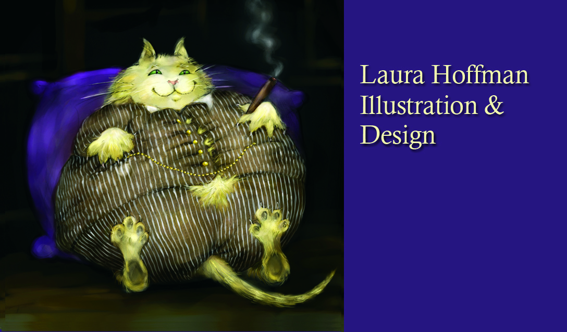
Laura Hoffman, Illustrator & Photographer

Slide 2
Liked to draw and make things…
(and hang out with dachshunds)
…even as a little kid.
I haven’t changed much.

Slide 3
Influences: Dr. Suess

Slide 4
Philippe Halsman’s Dali Atomicus, 1941

Slide 5
Inspired by Norman Rockwell

Slide 6
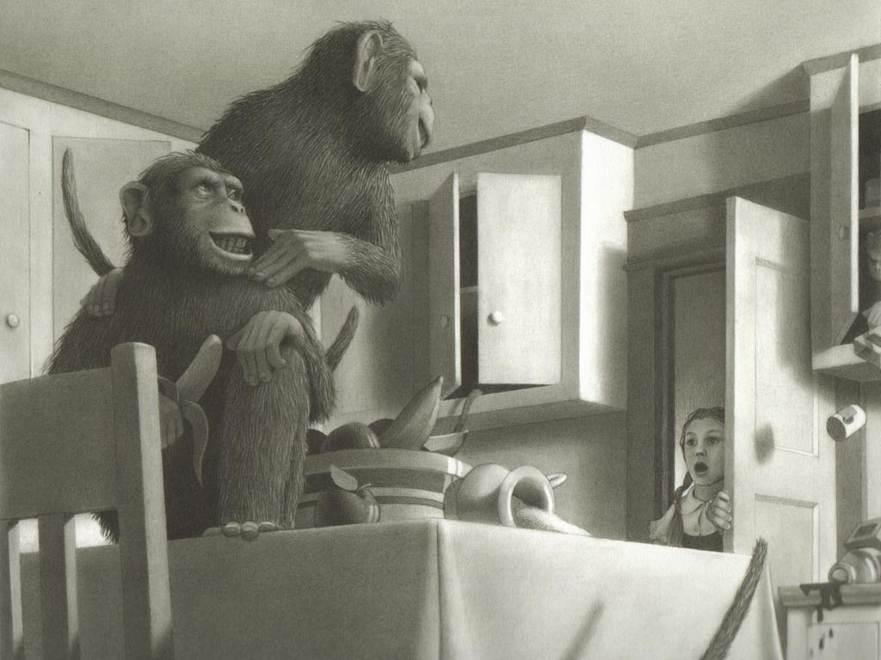
Inspired by Chris Von Allsburg & David Wiesner, both Caldecott winners.

Slide 7
Influenced By Mad Magazine
Sergio Aragones
Don Martin

Slide 8
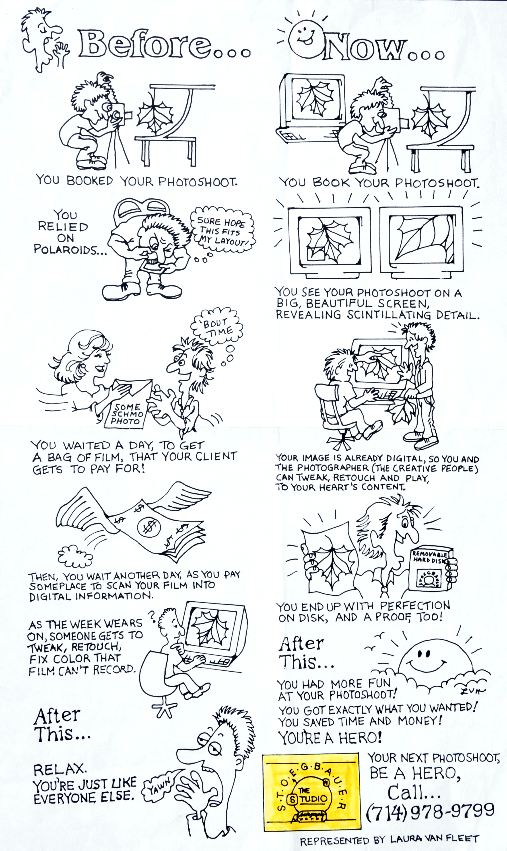

Slide 9
Early commercial work

Slide 10
Early commercial work: The Tech Bubble Years

Slide 11
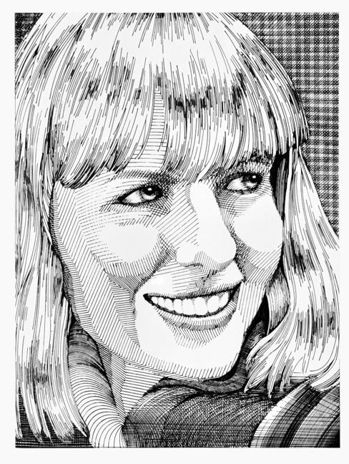
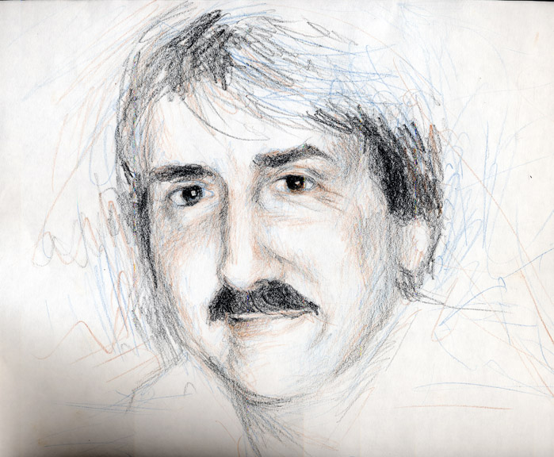
Early Portrait work

Slide 12
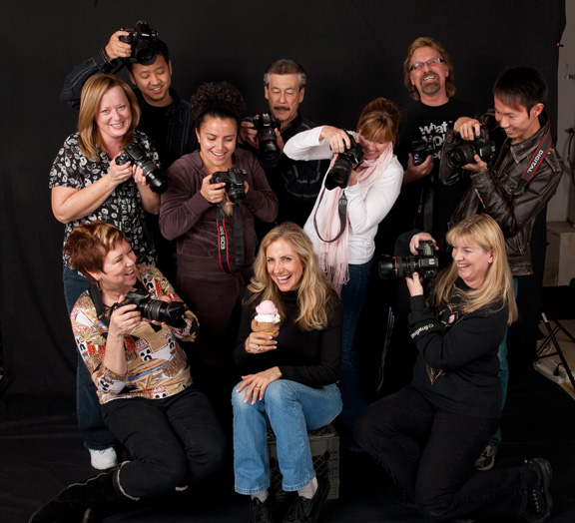
Dual Careers: Photography + Illustration
Photography Instructor,
Saddleback College:

Slide 13
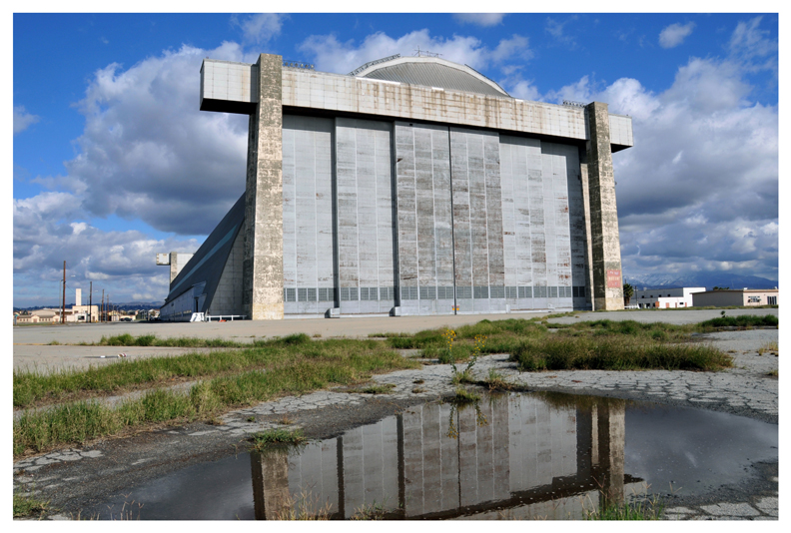
Photography

Slide 14
Photography

Slide 15
Specialty: Glass, lighting, crystal and prism photography

Slide 16
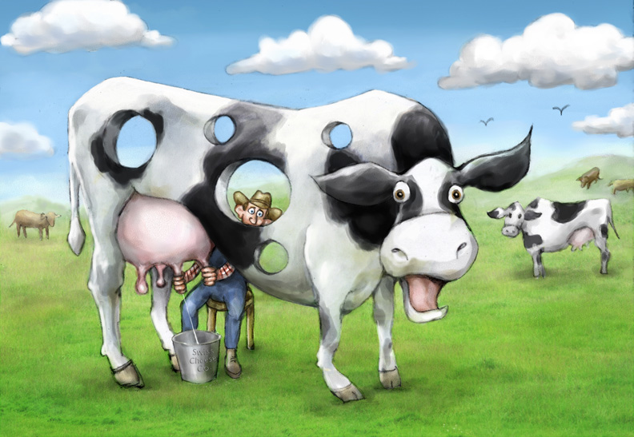
My Illustrations
Create narrative illustrations with a sense of humor, heart and joy.

Slide 17
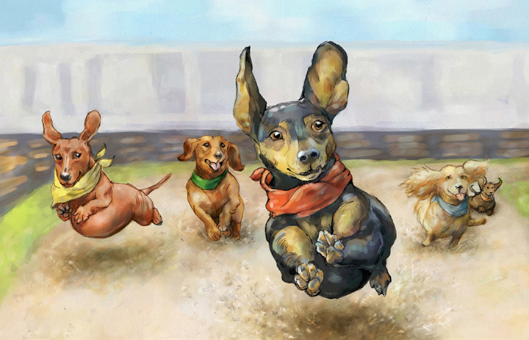
Create narrative illustrations with a sense of humor, heart and joy.

Slide 18
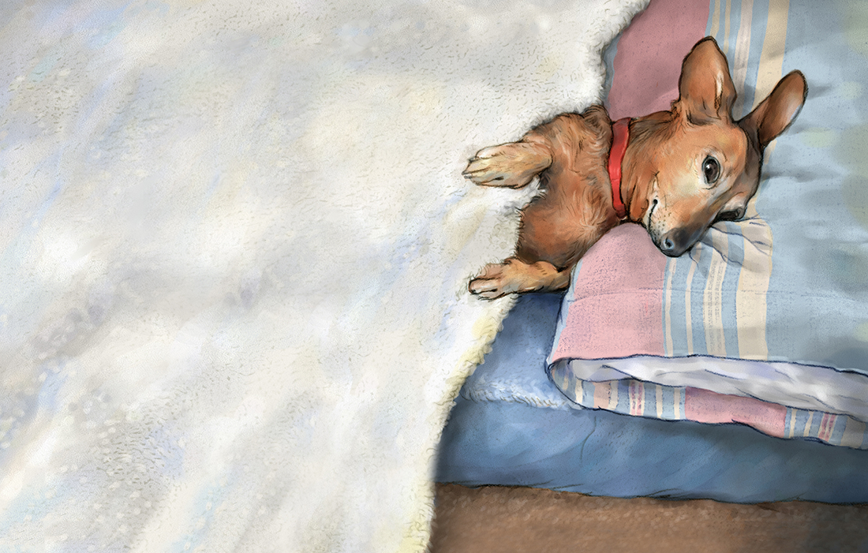

Slide 19
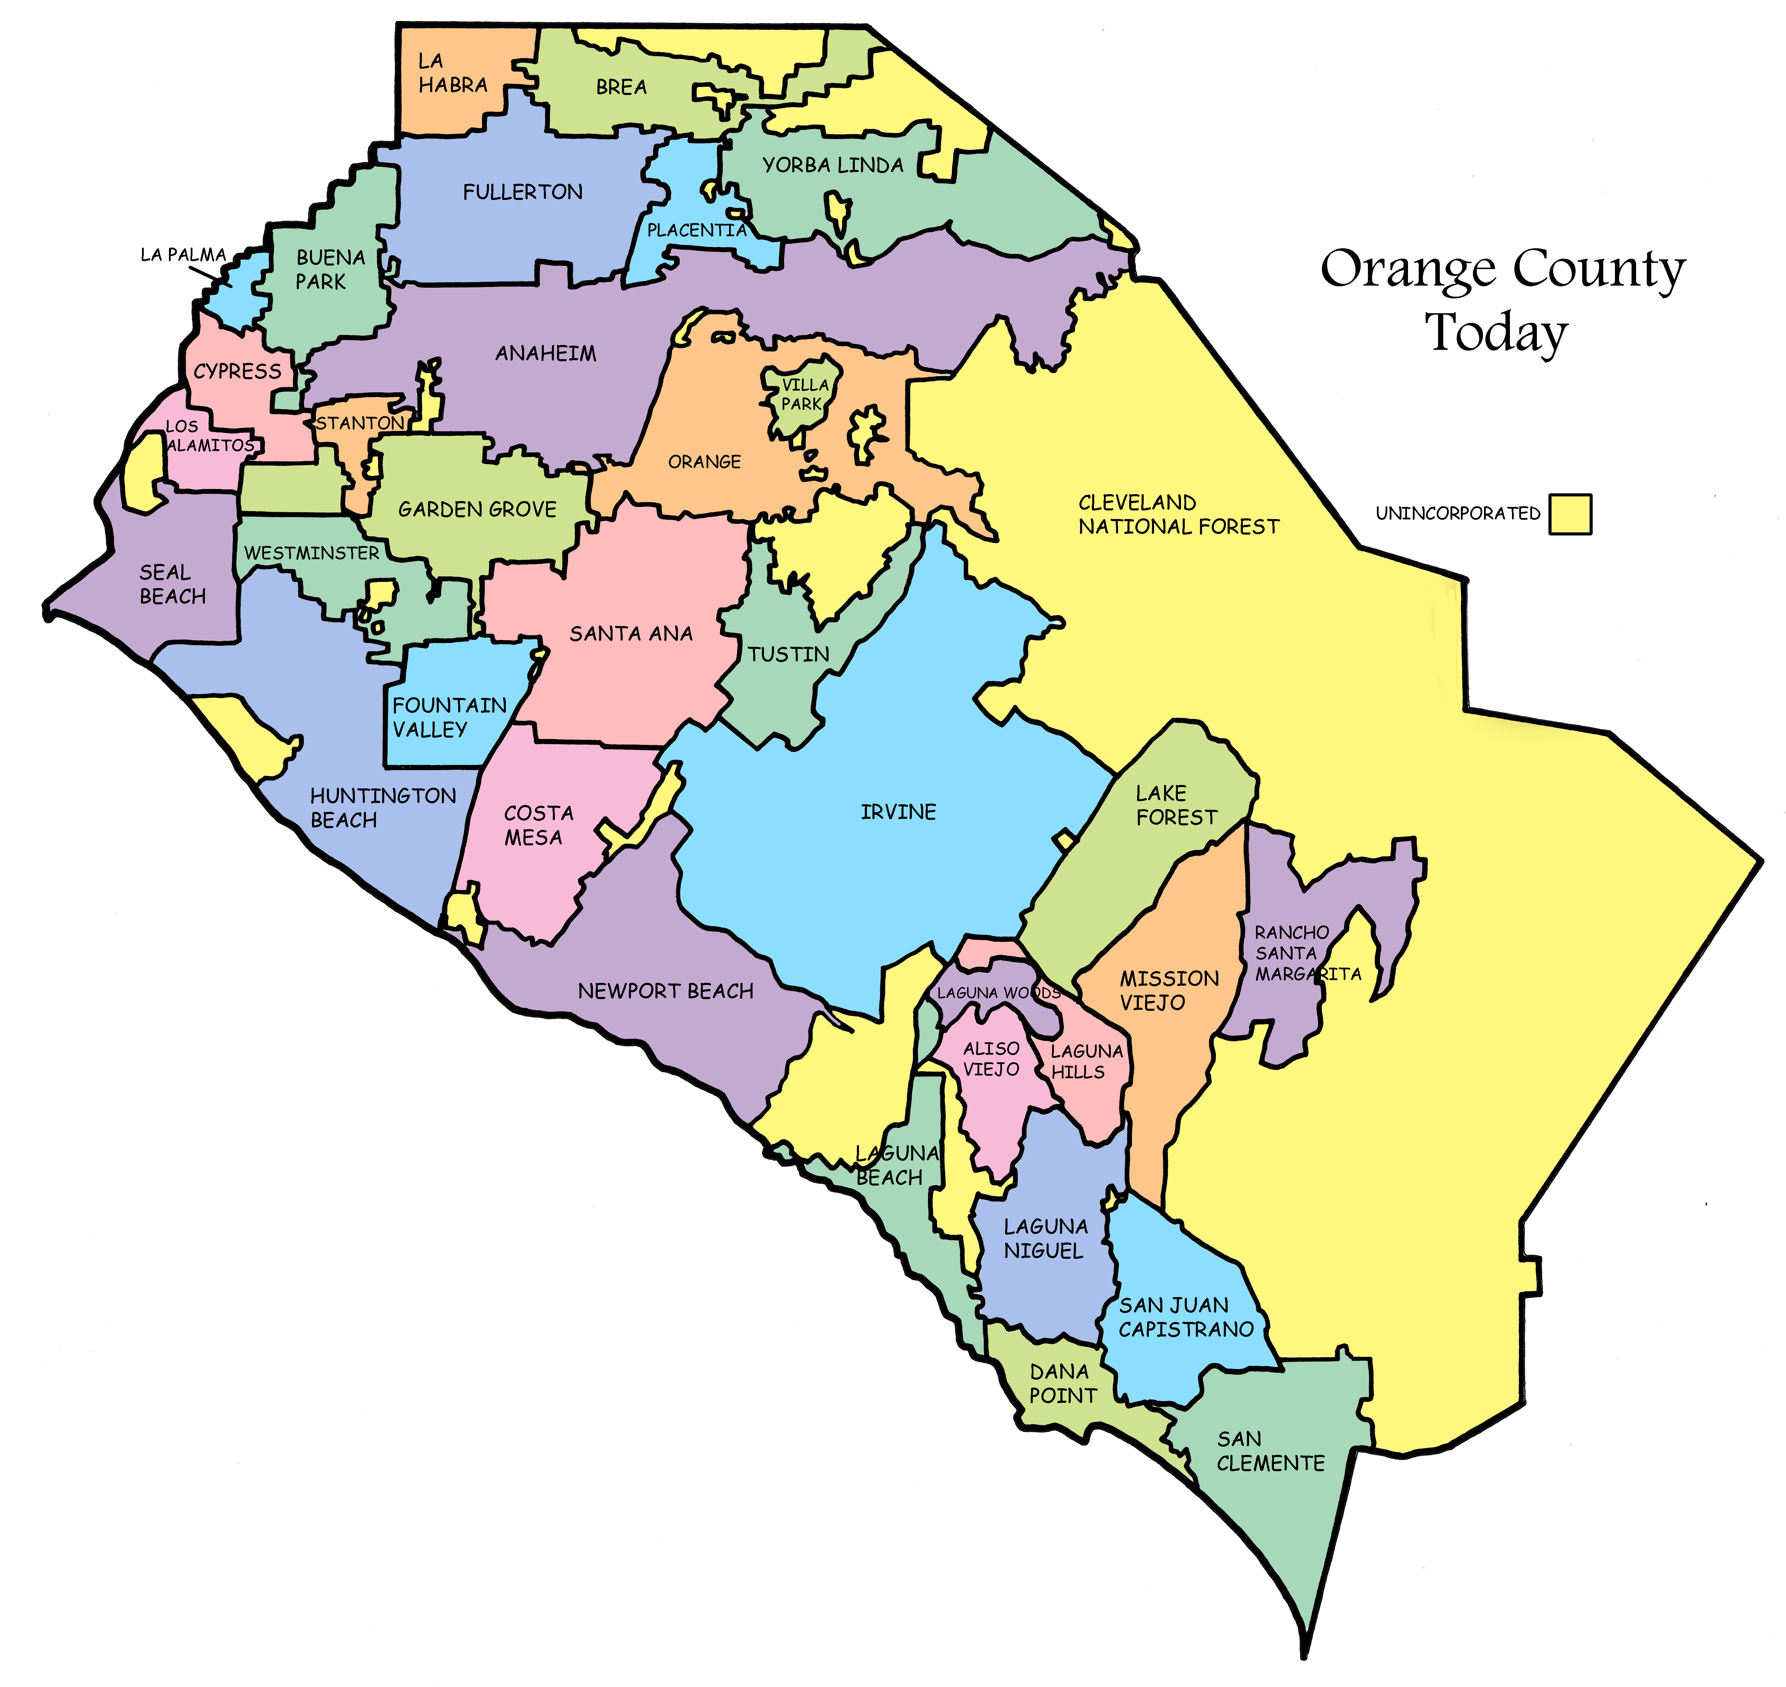
Illustration projects

Slide 20
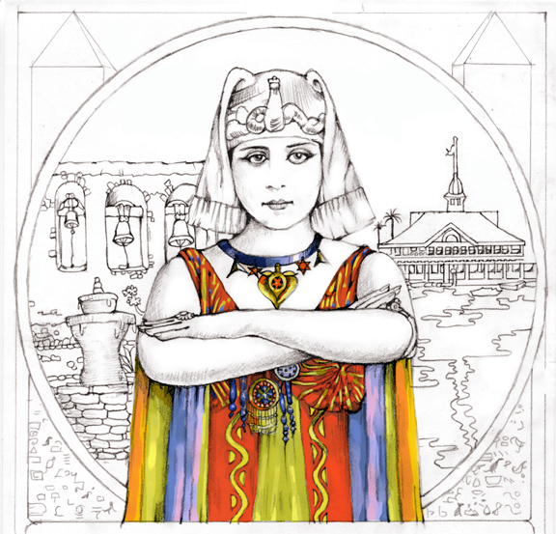
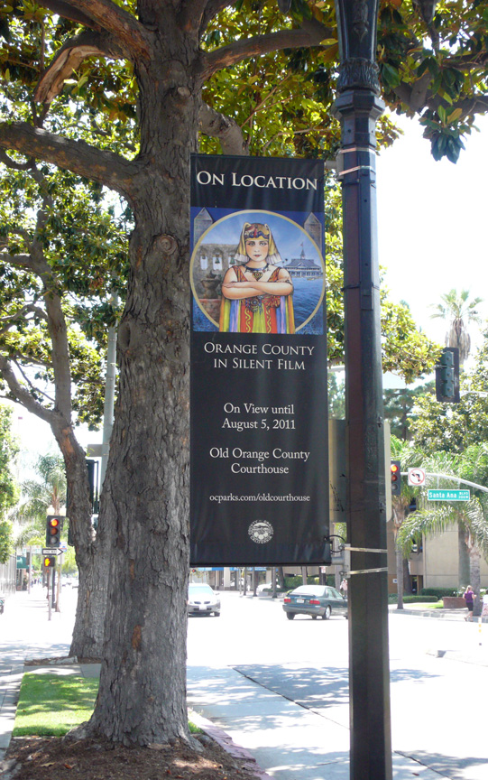
Illustration Projects

Slide 21
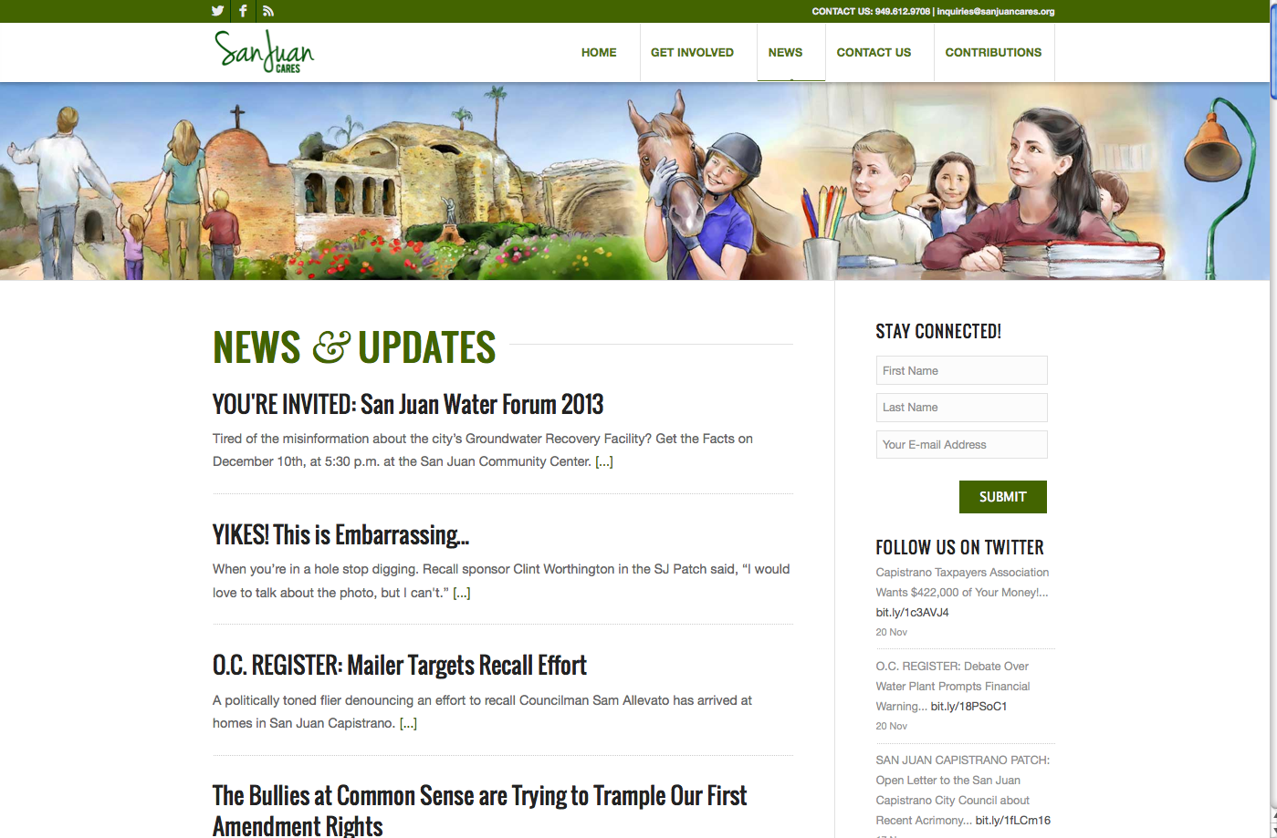

Slide 22
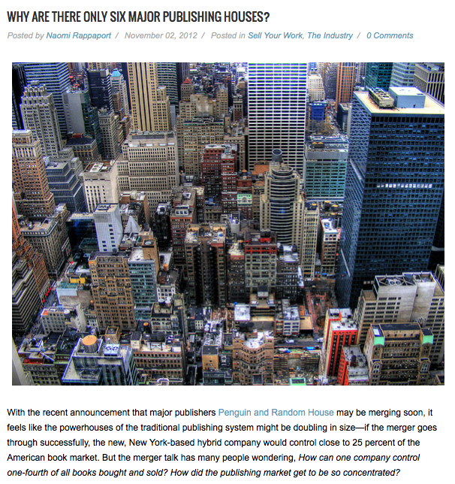
Old Days: You dropped off your portfolio at a major publishing house.

Slide 23
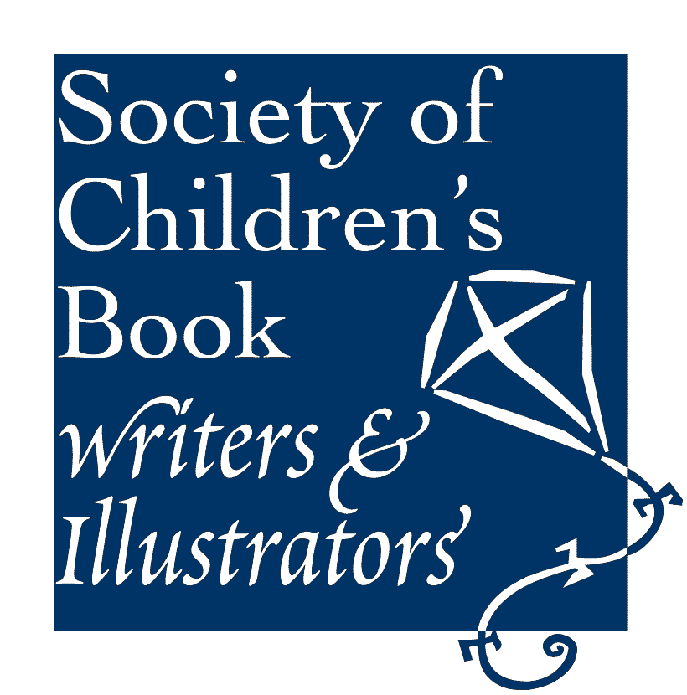
In 2010, I joined SCBWI: The Society of Childrens Book Writers & Illustrators

Slide 24
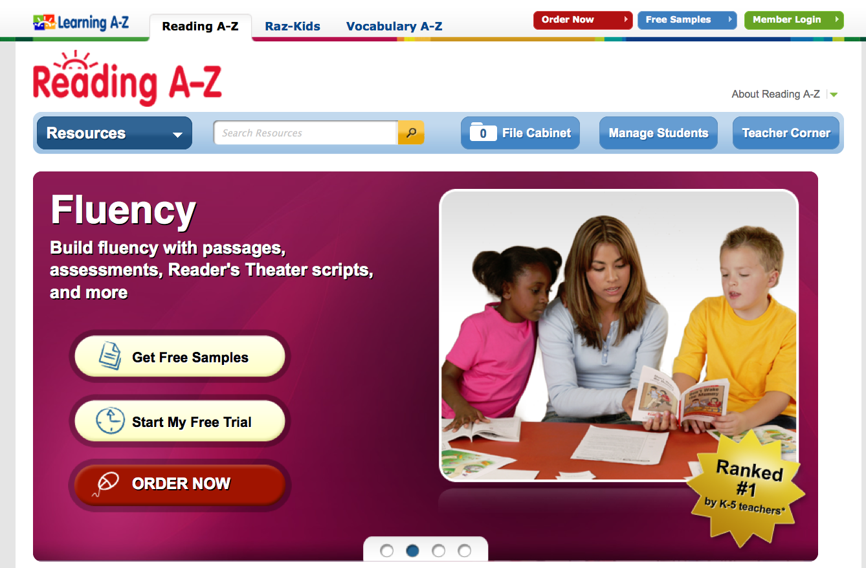
A Major Educational Publisher Found Me.

Slide 25
Now I illustrate books for kids.

Slide 26
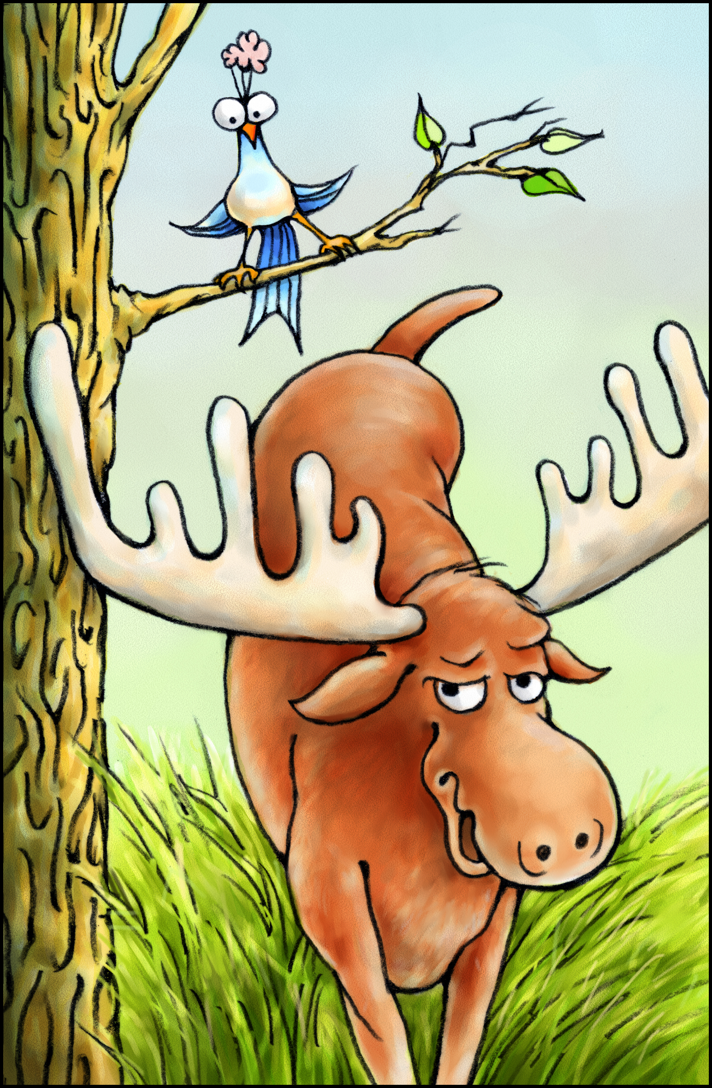
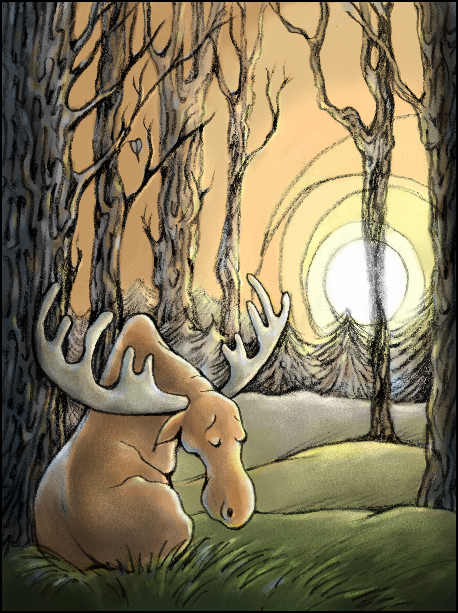
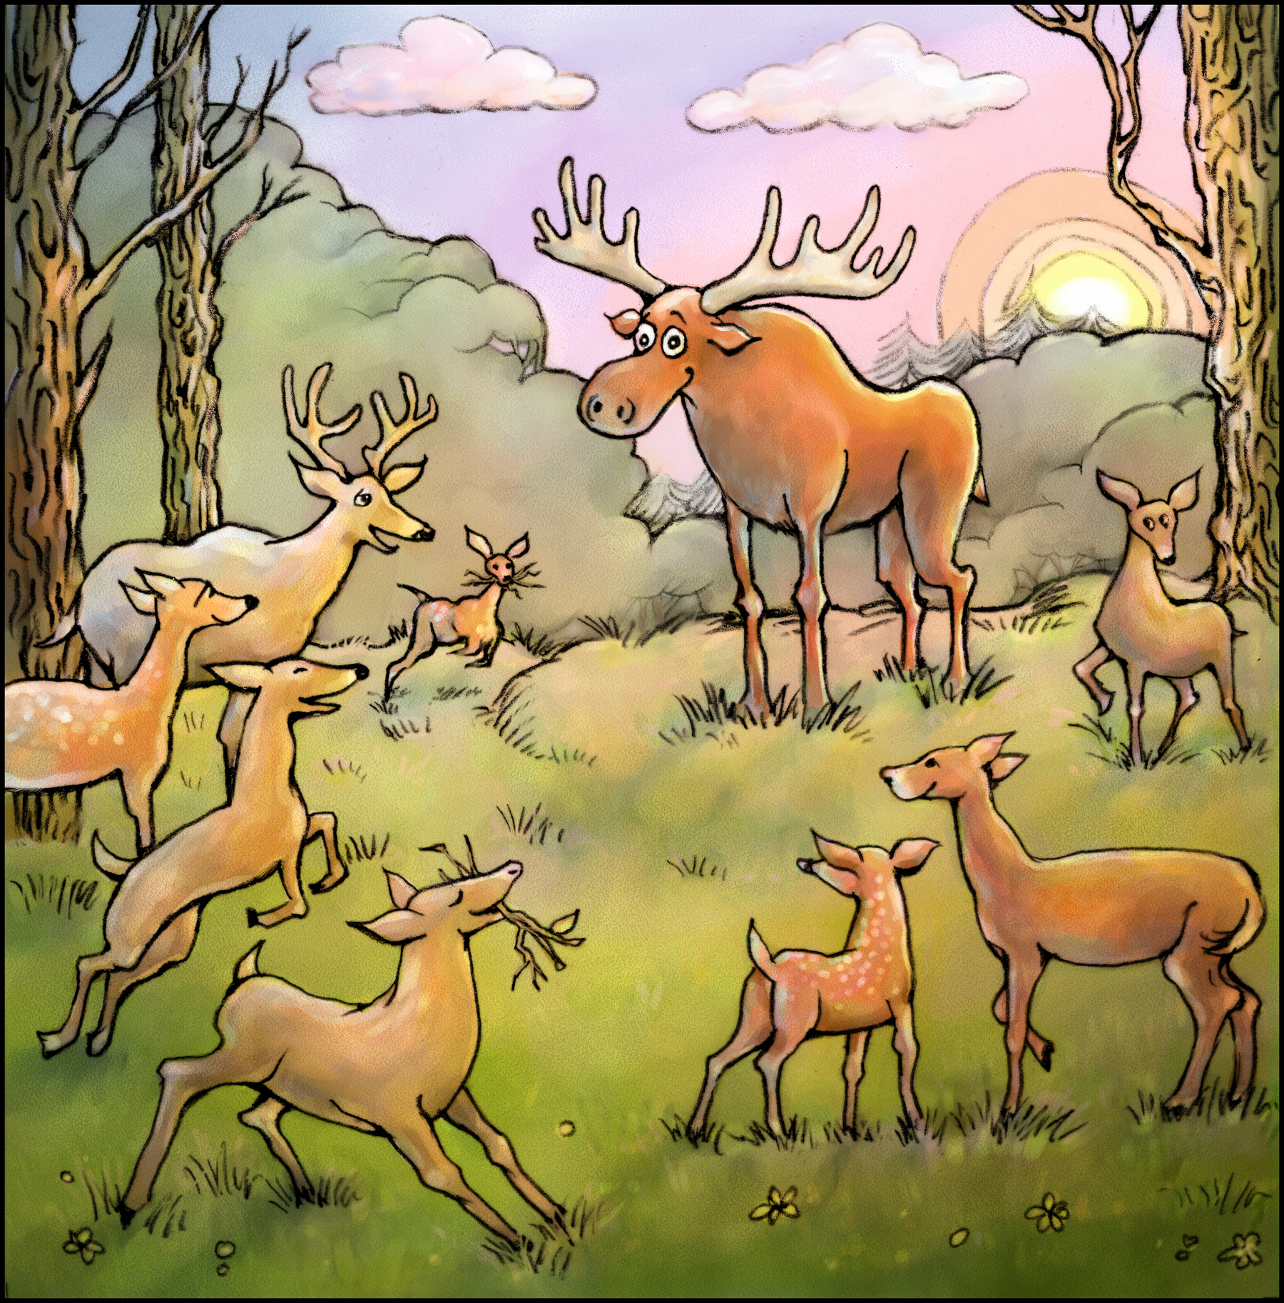
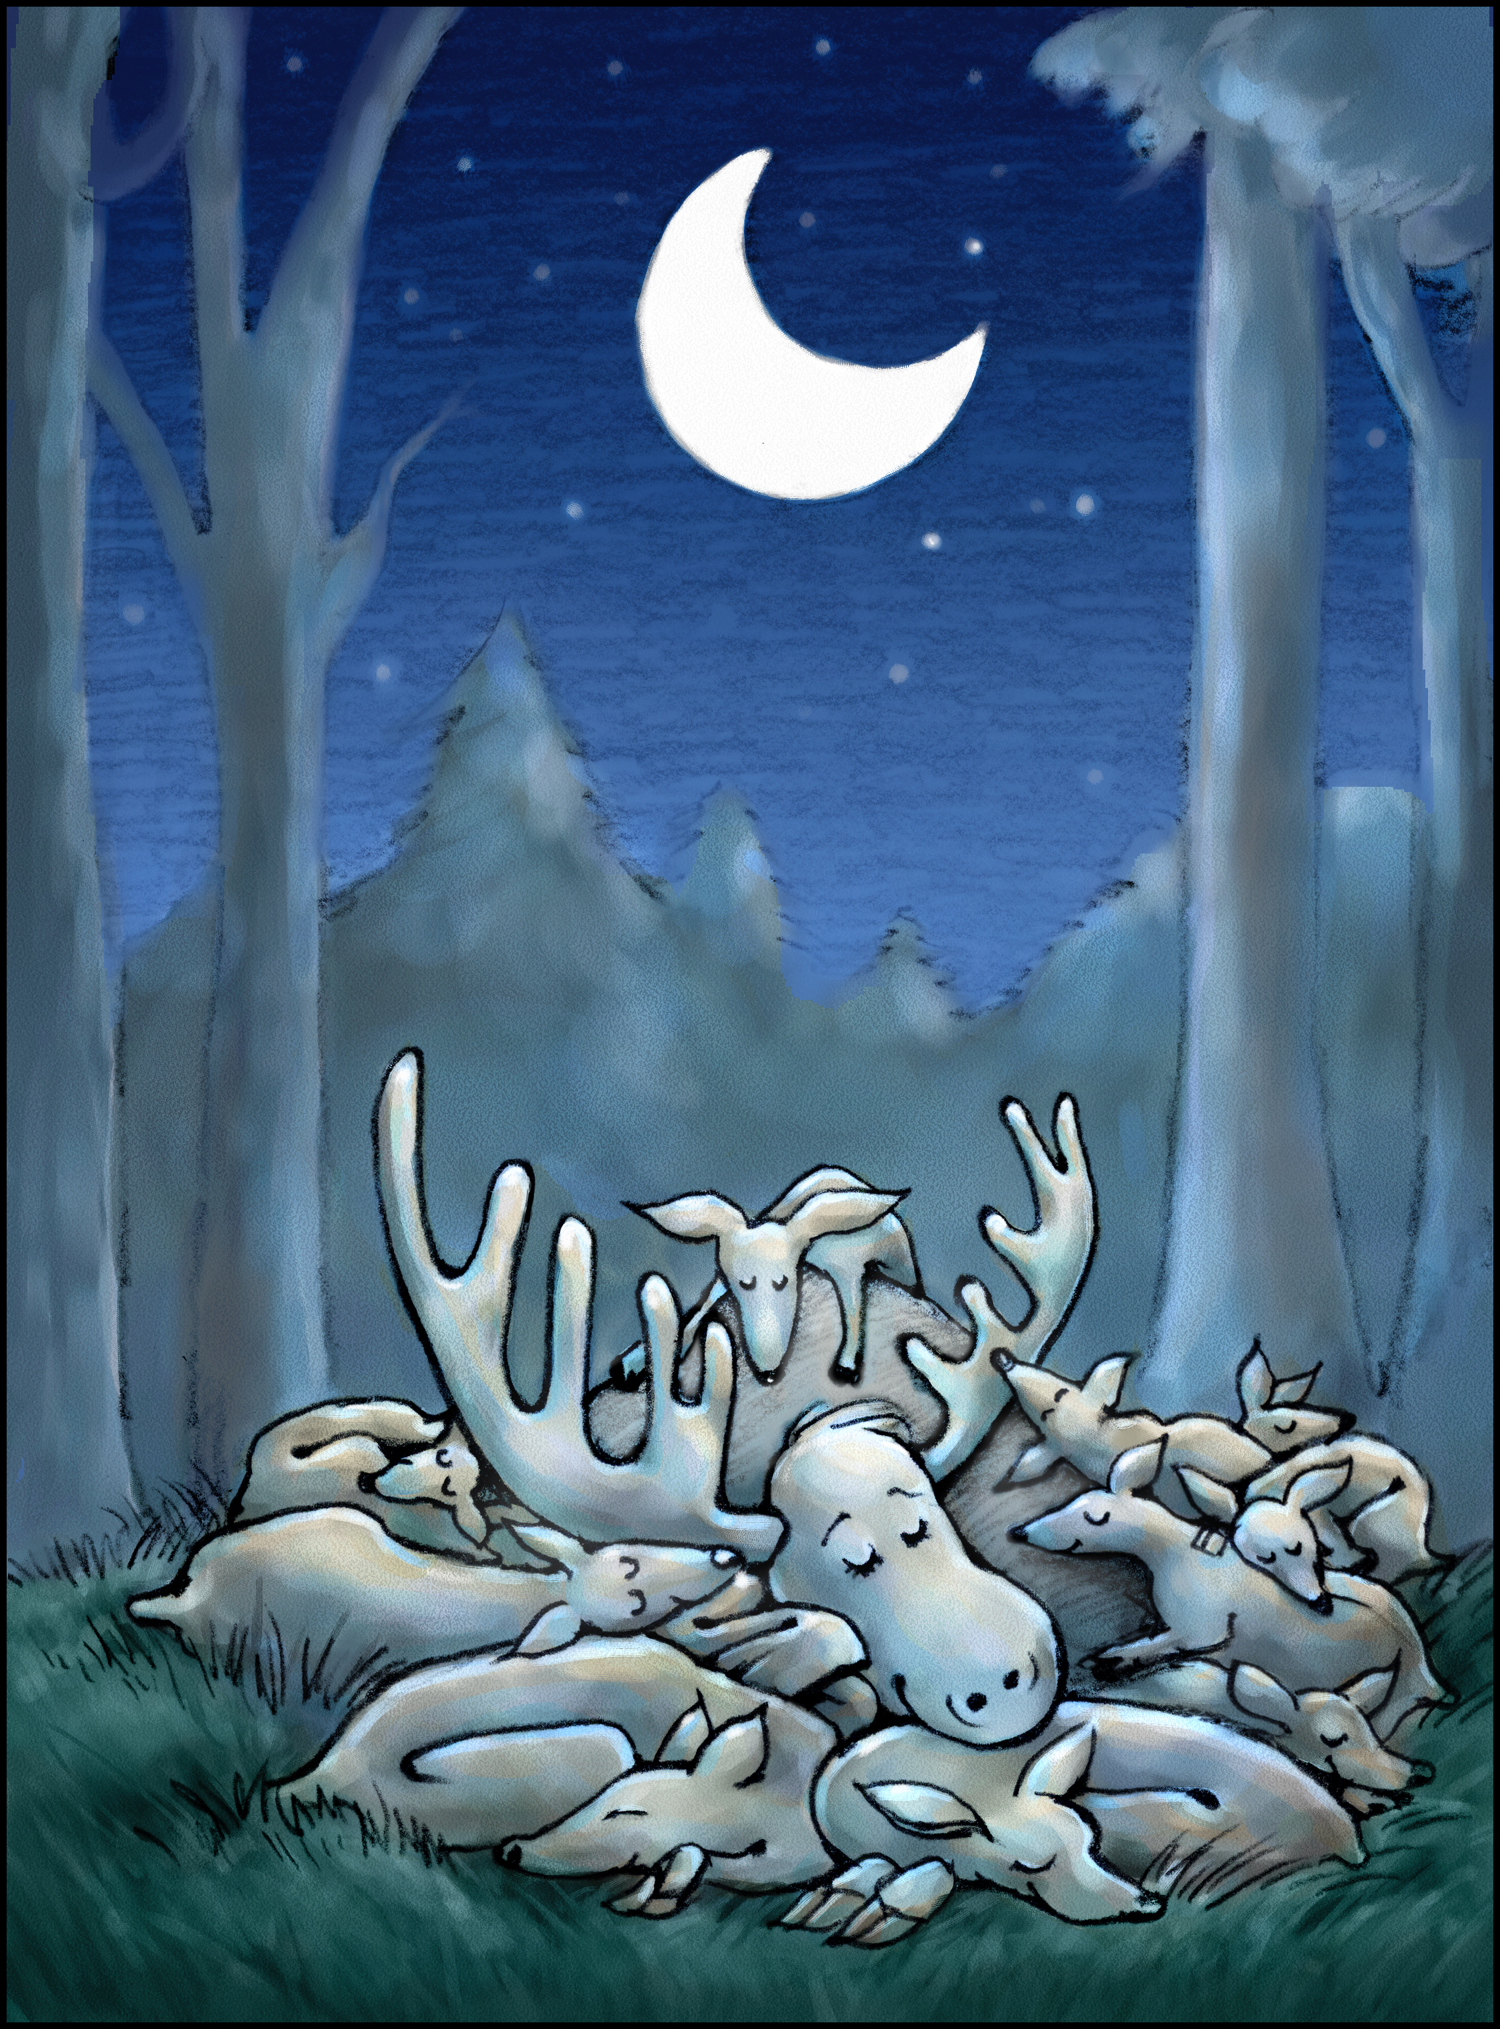

Slide 27
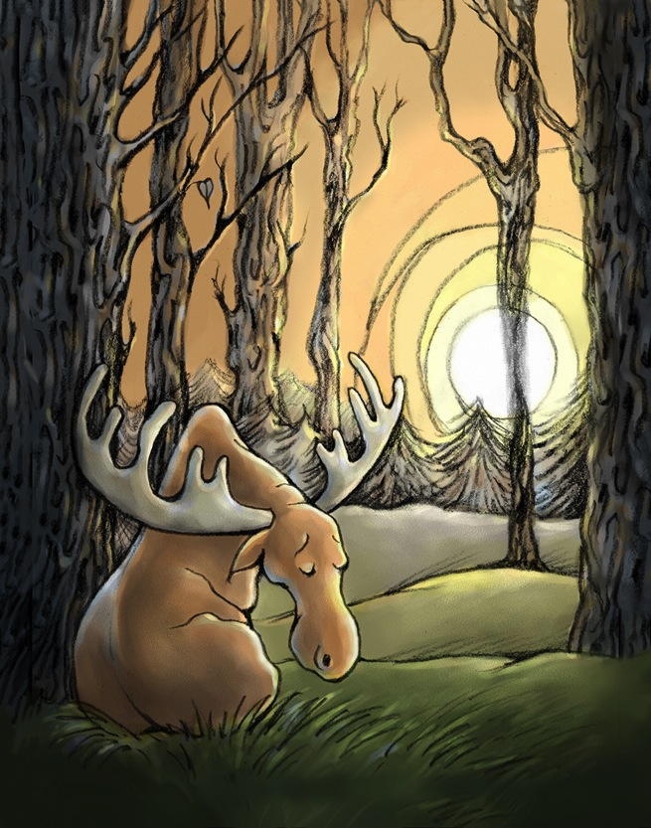
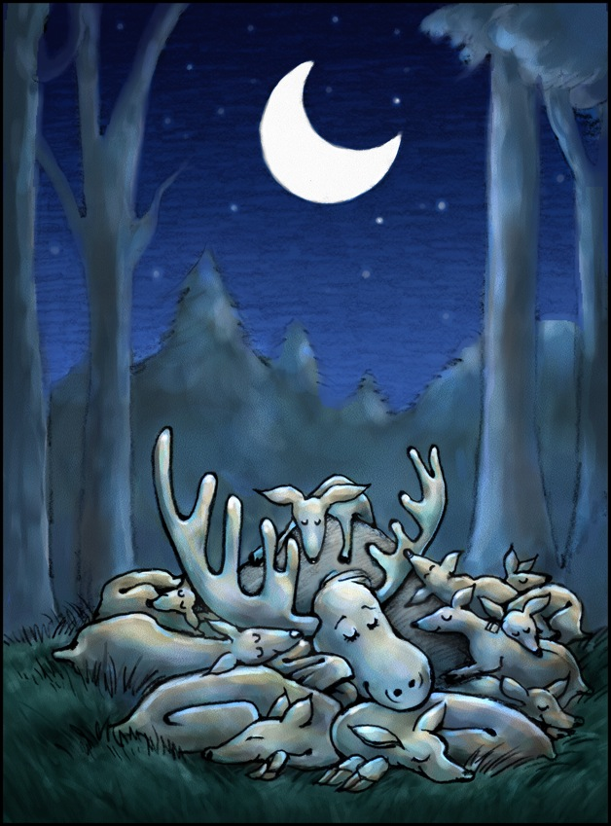

Slide 28
Illustration Projects: CHILDRENS BOOKS

Slide 29
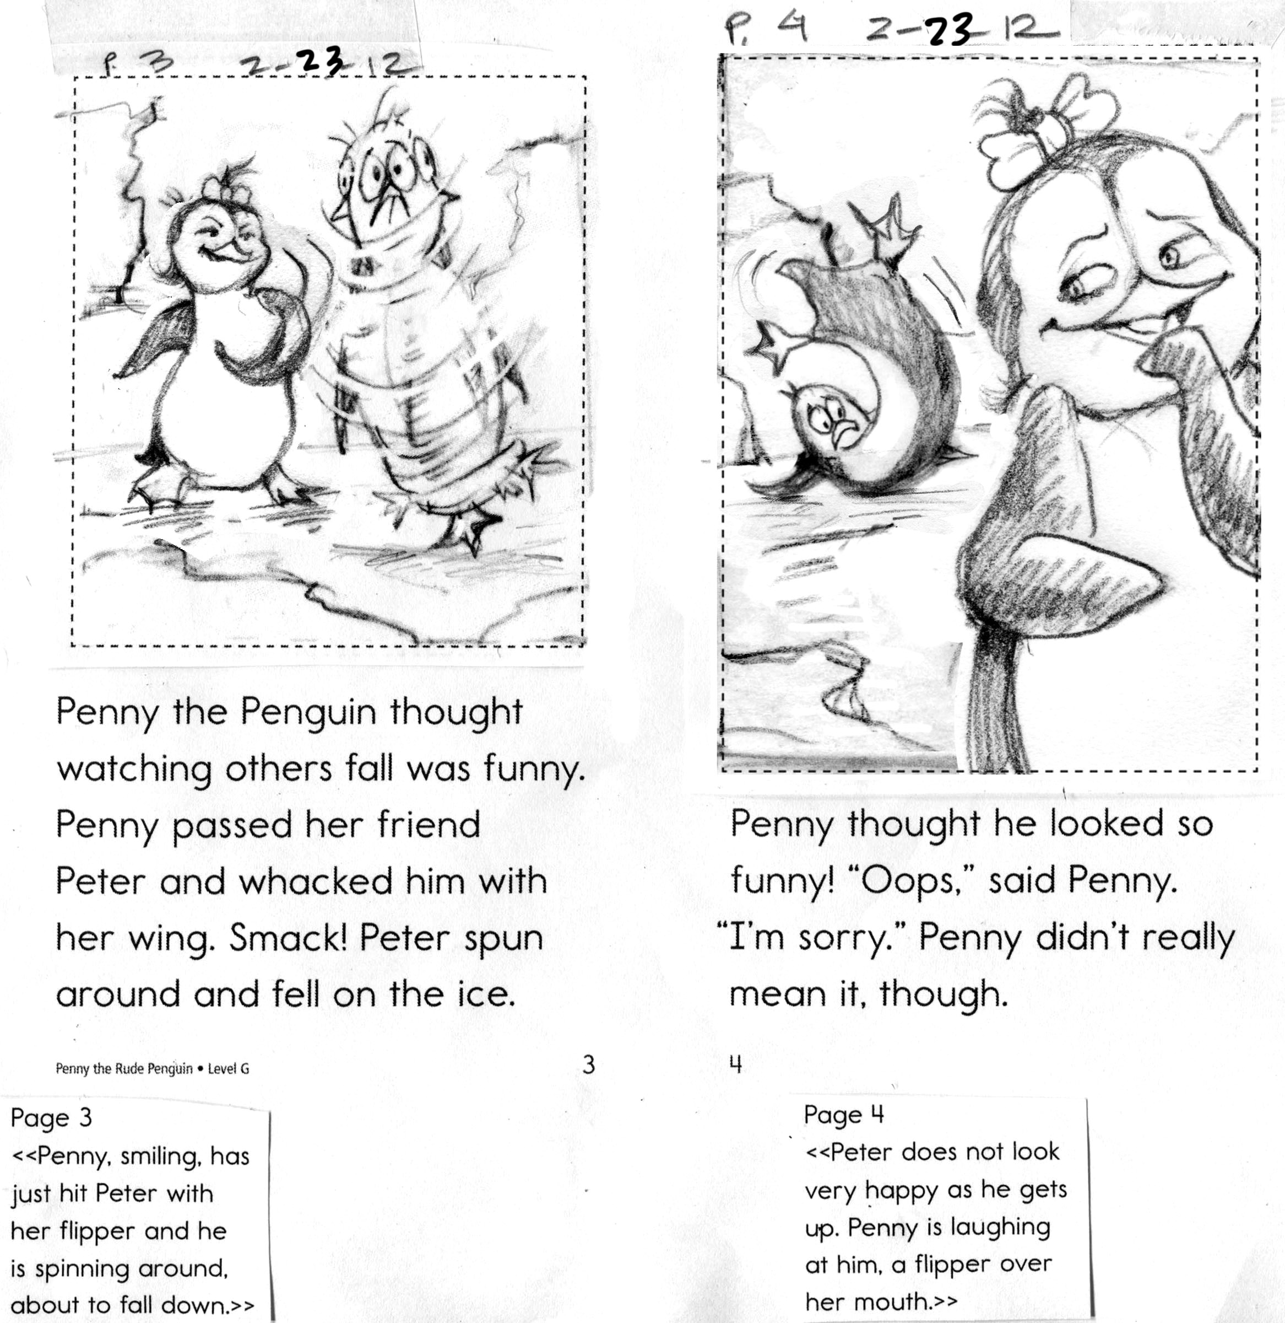

Slide 34
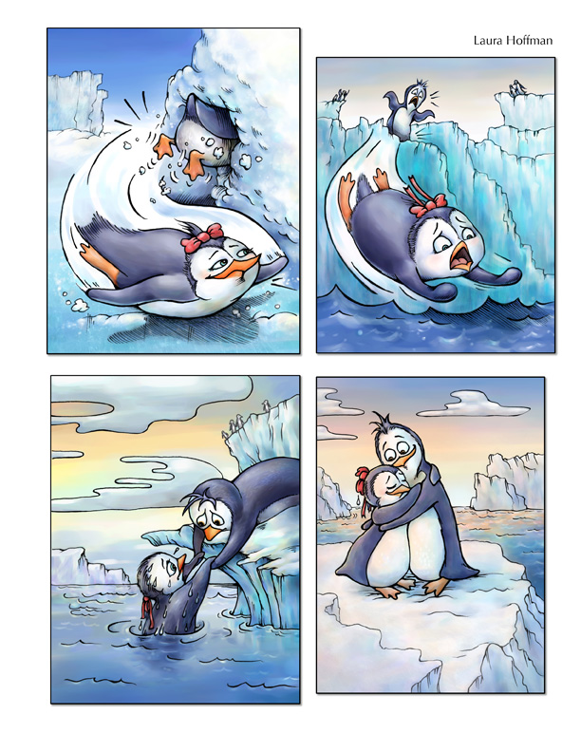

Slide 35
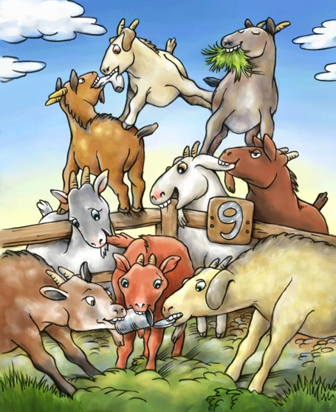
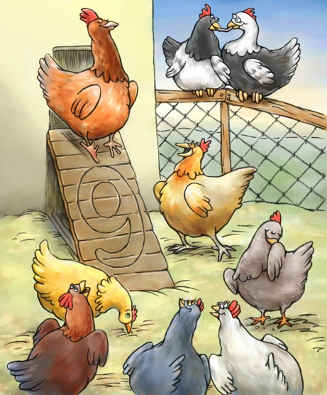
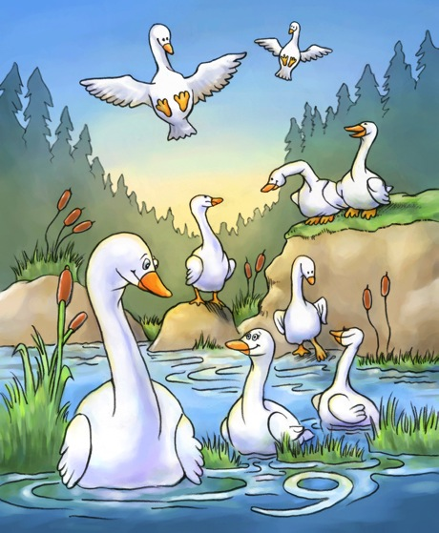

Slide 36
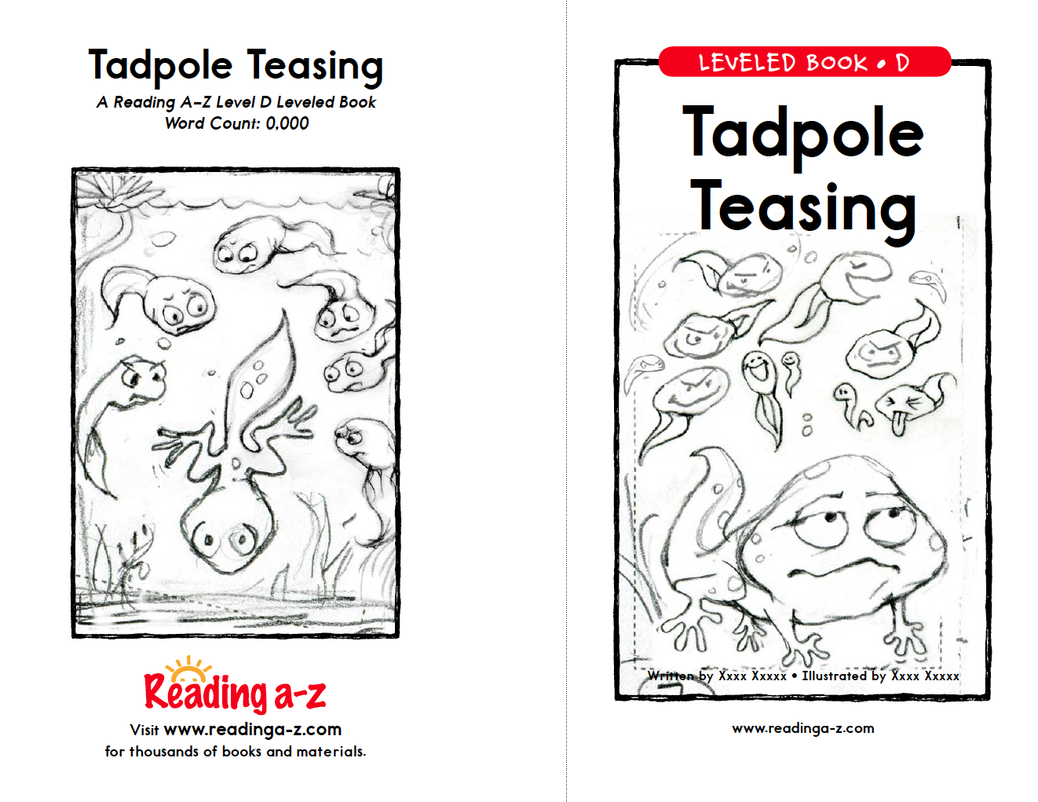
Illustration Projects: CHILDRENS BOOKS

Slide 37
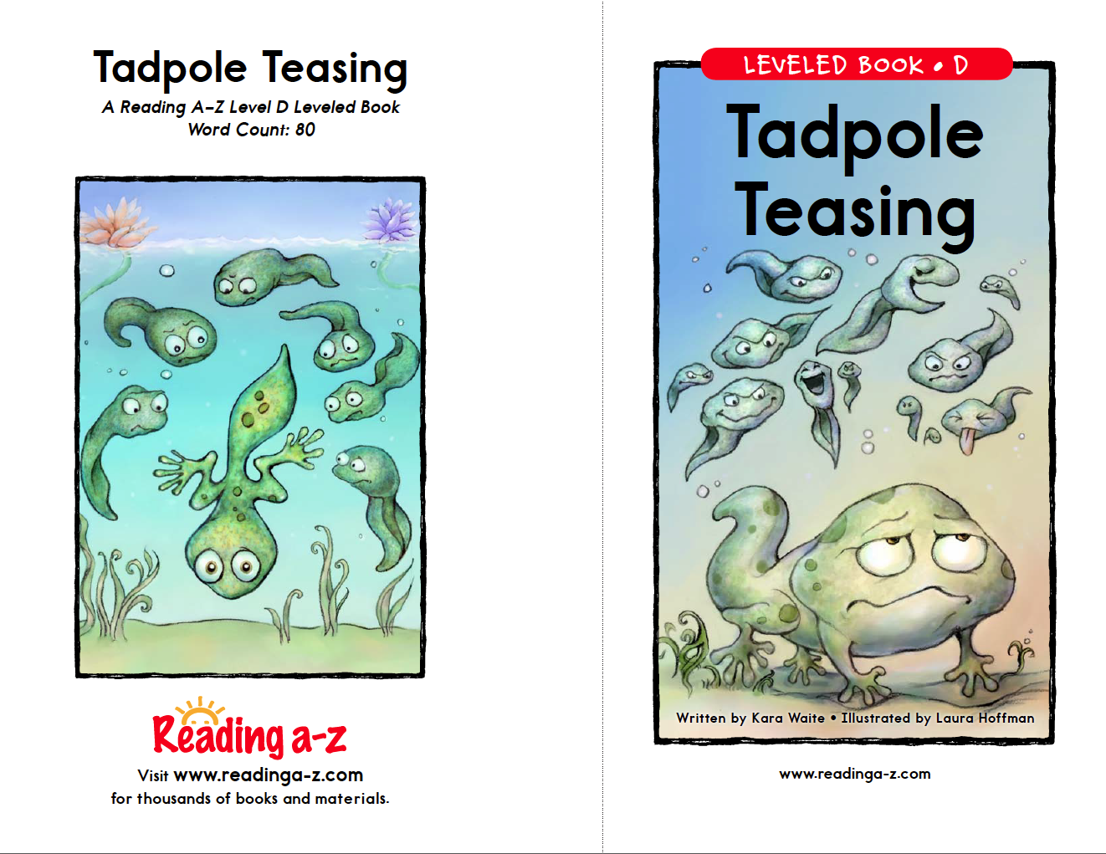
Illustration Projects: CHILDRENS BOOKS

Slide 38
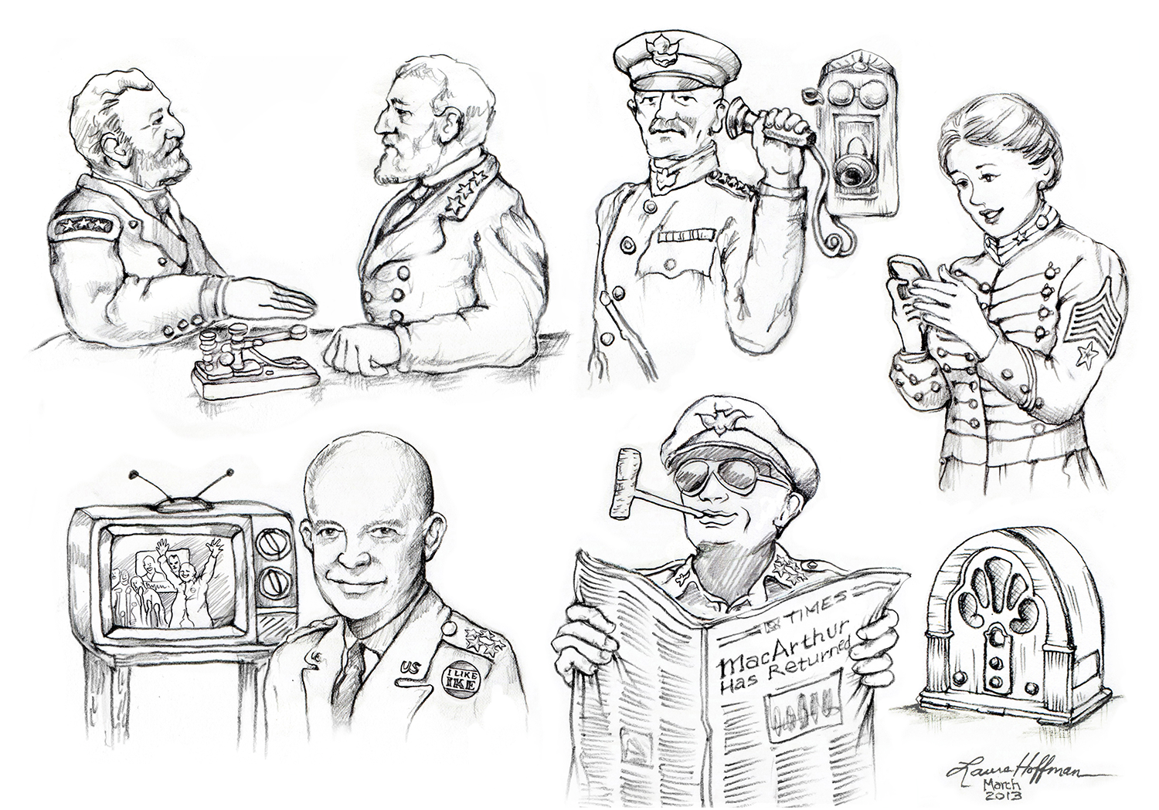

Slide 39
Illustration Projects: CHILDRENS BOOKS

Slide 40
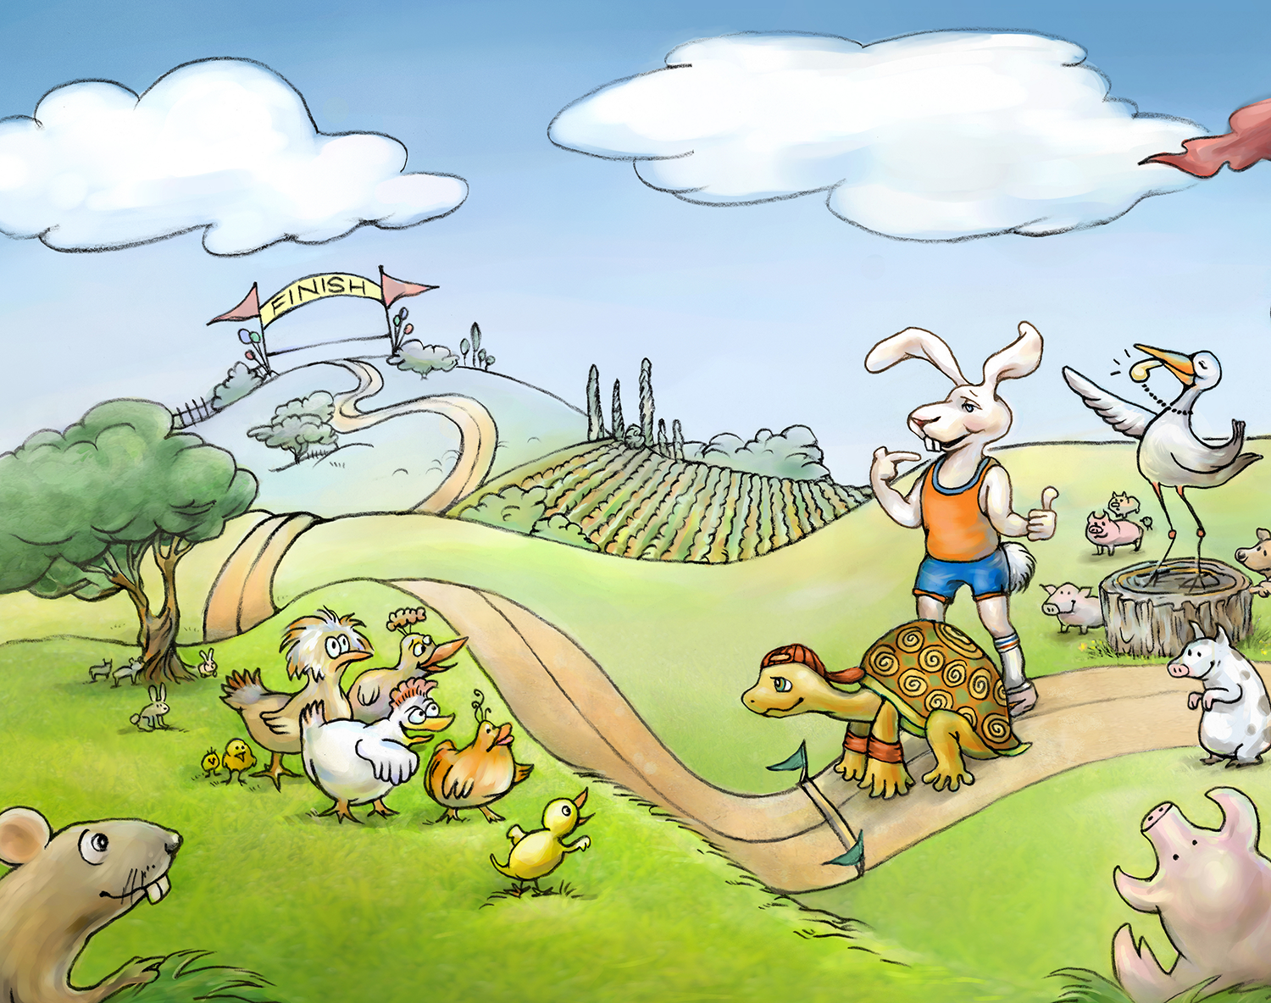
Illustration Projects: CHILDRENS BOOKS

Slide 41
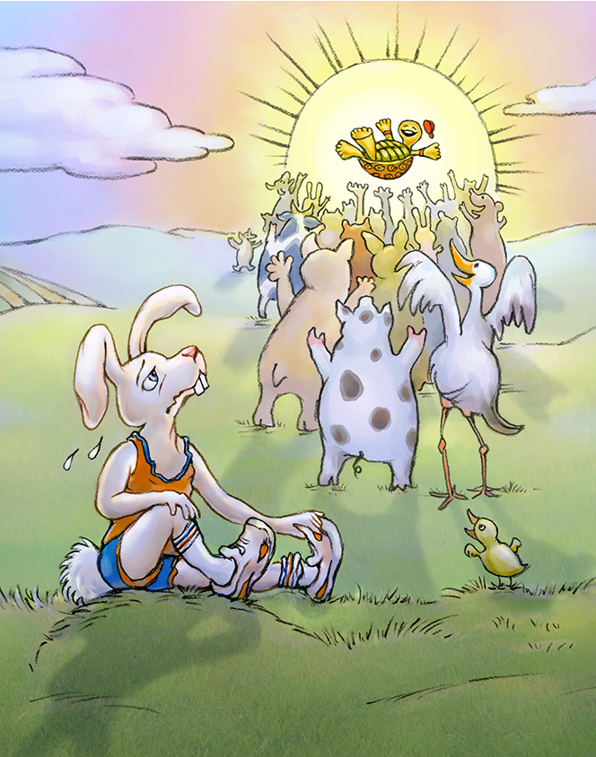
Slow and Steady Wins the Race!

Slide 42
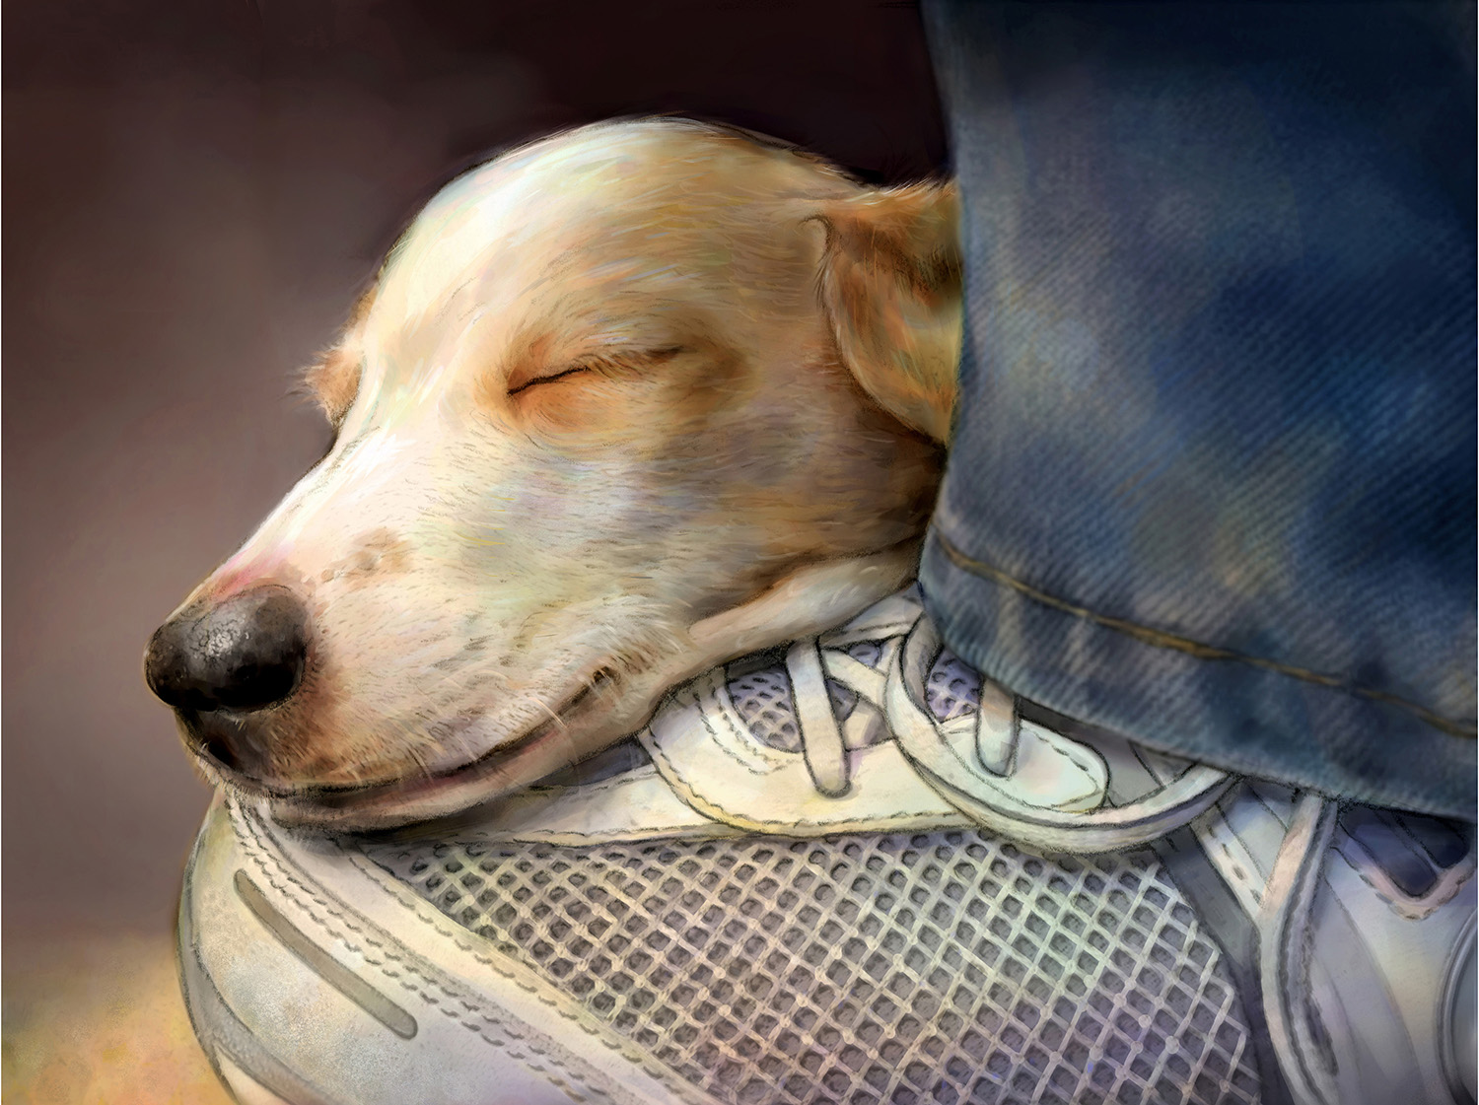

Slide 43
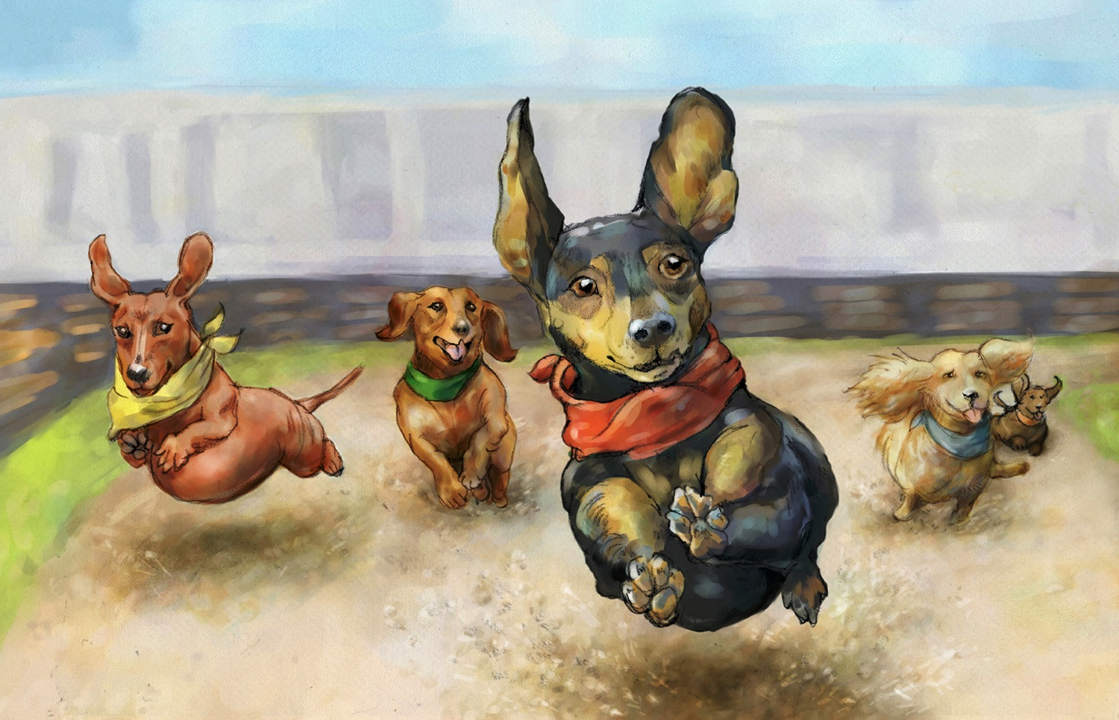

Slide 44
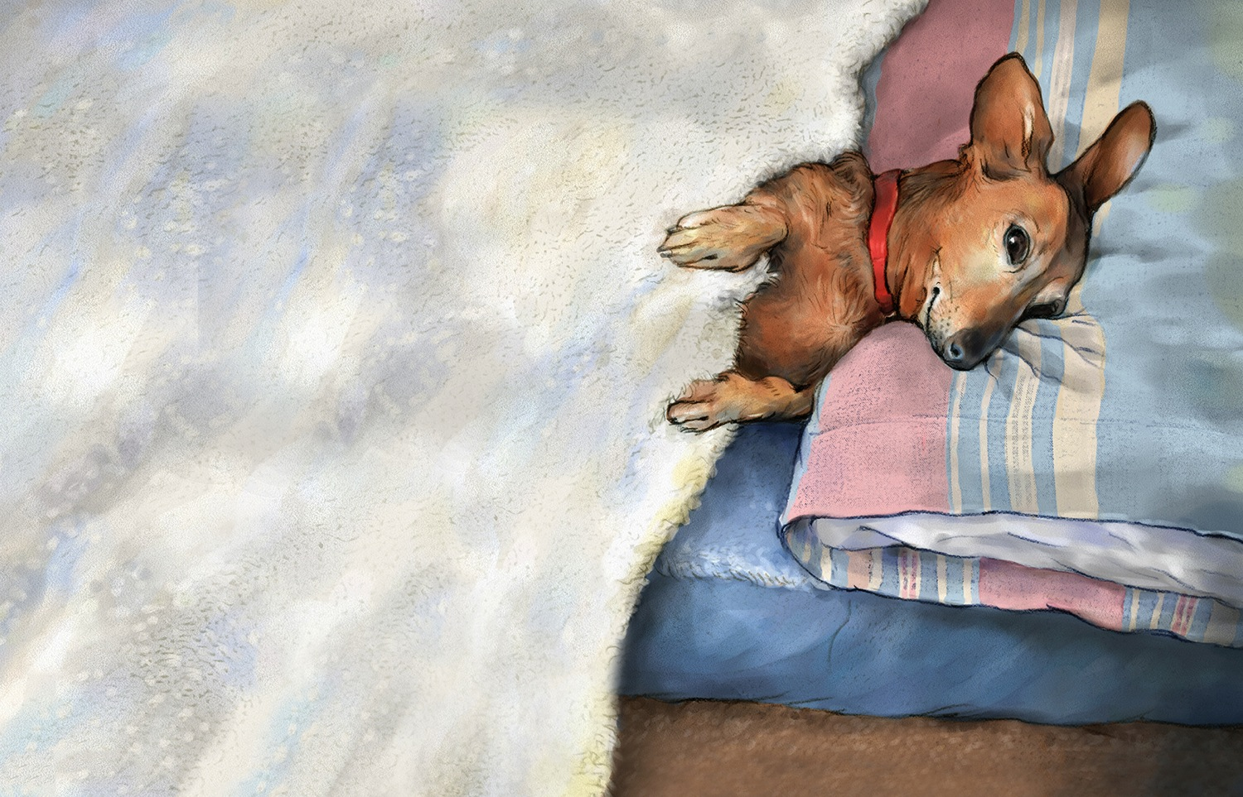

Slide 45
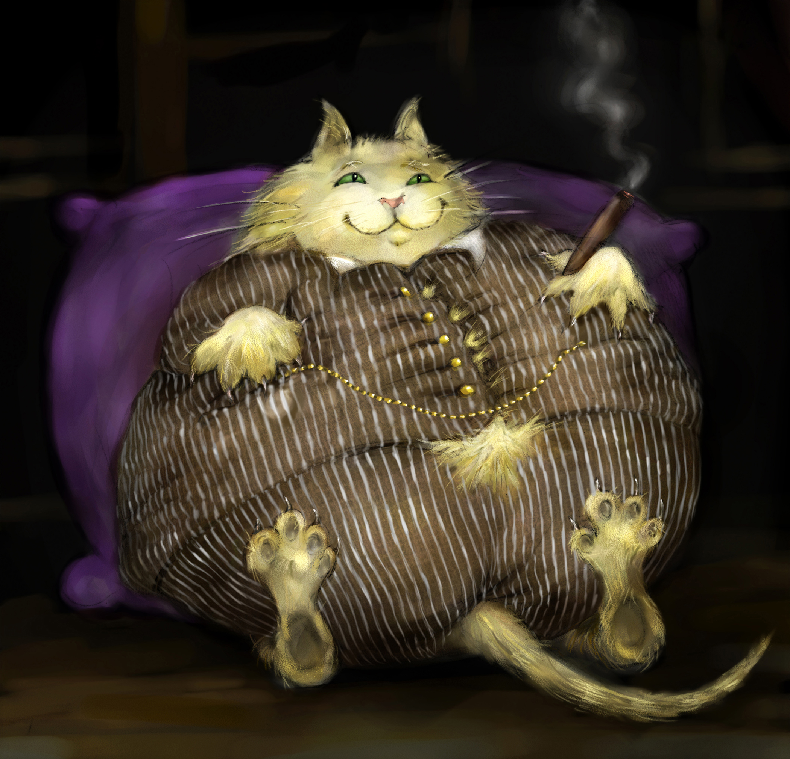

Slide 46
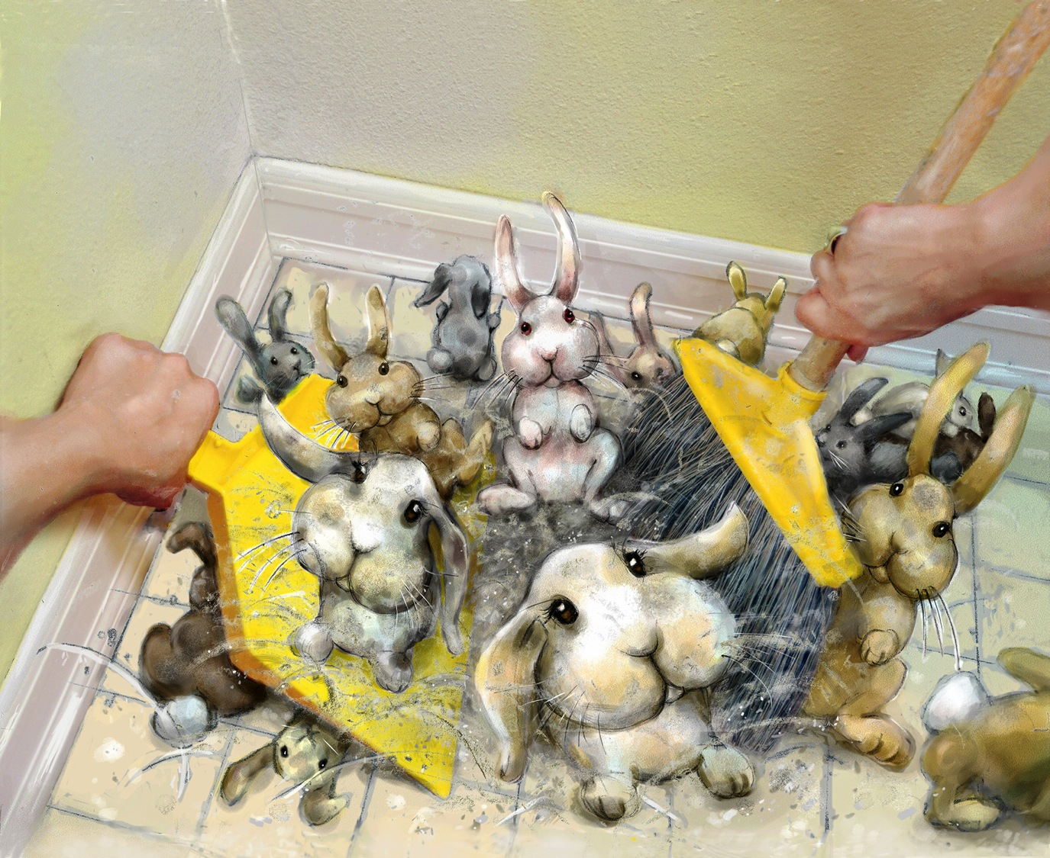

Slide 47
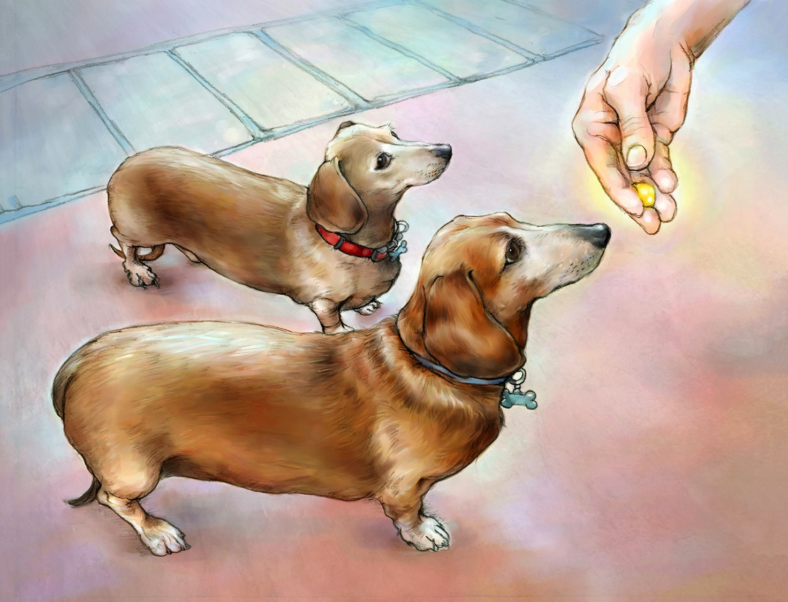

Slide 48
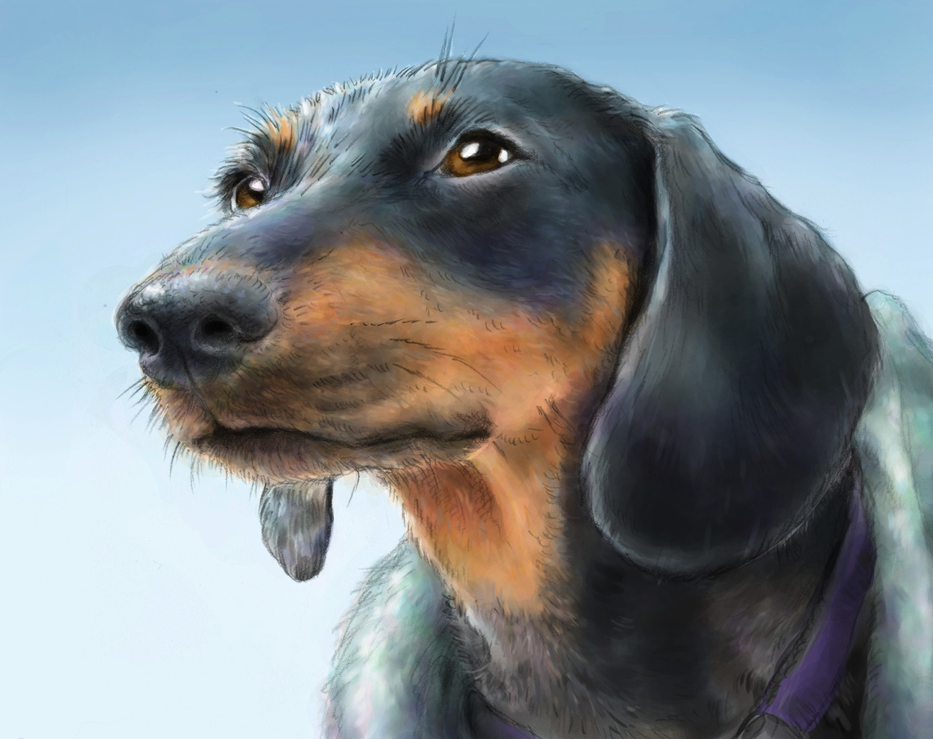

Slide 49
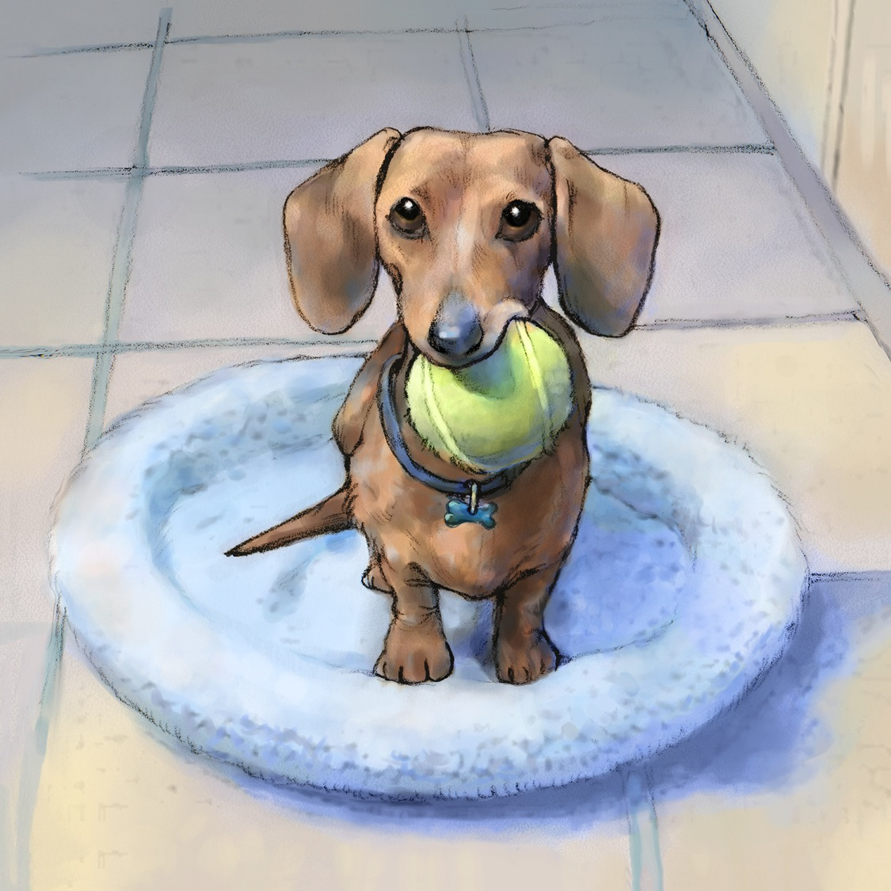

Slide 51
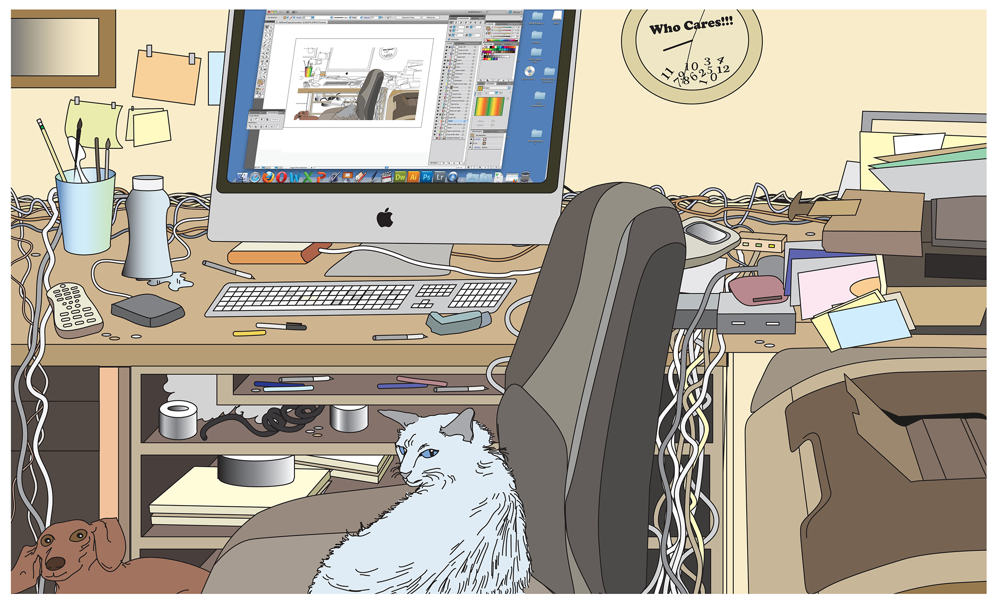

Slide 53
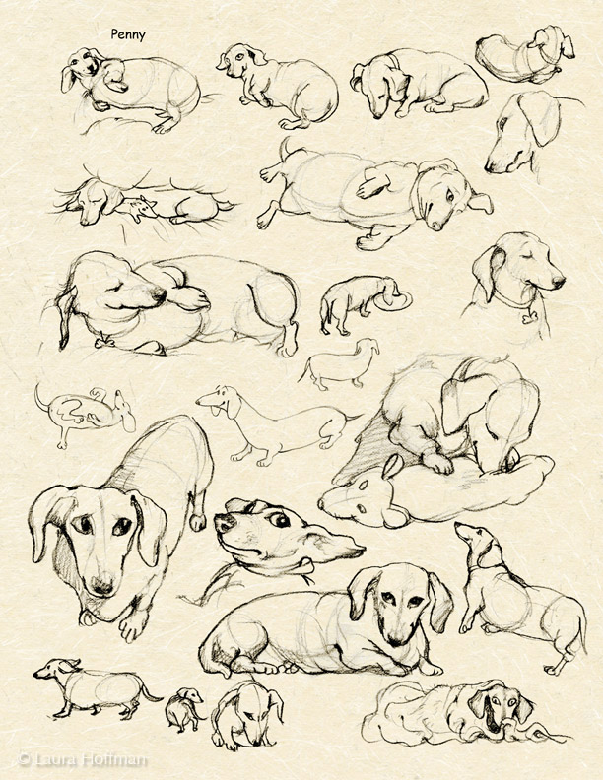

Slide 54
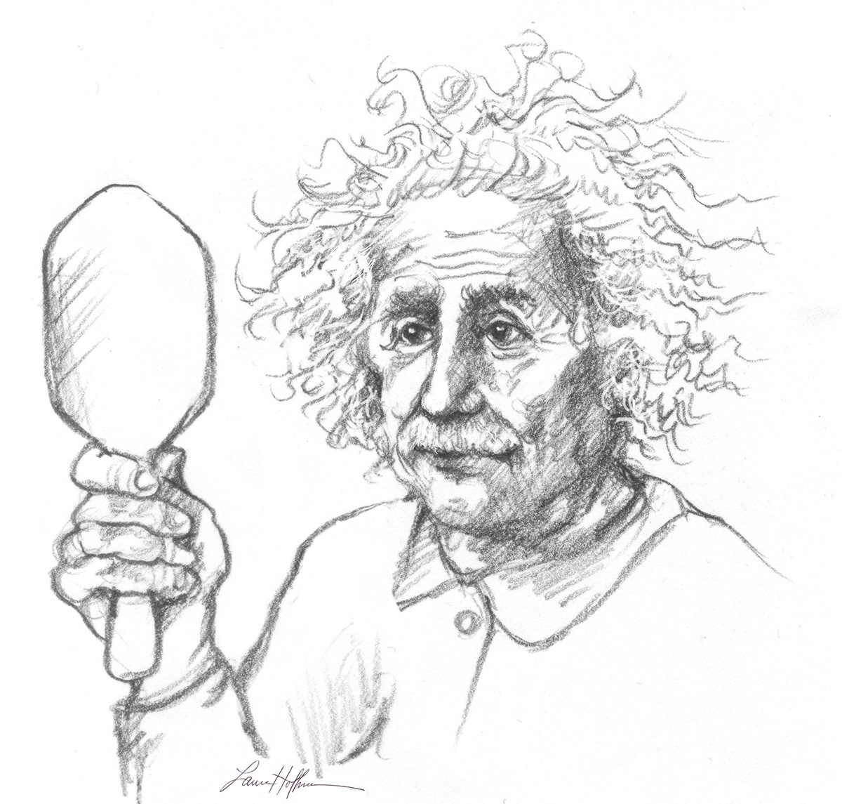
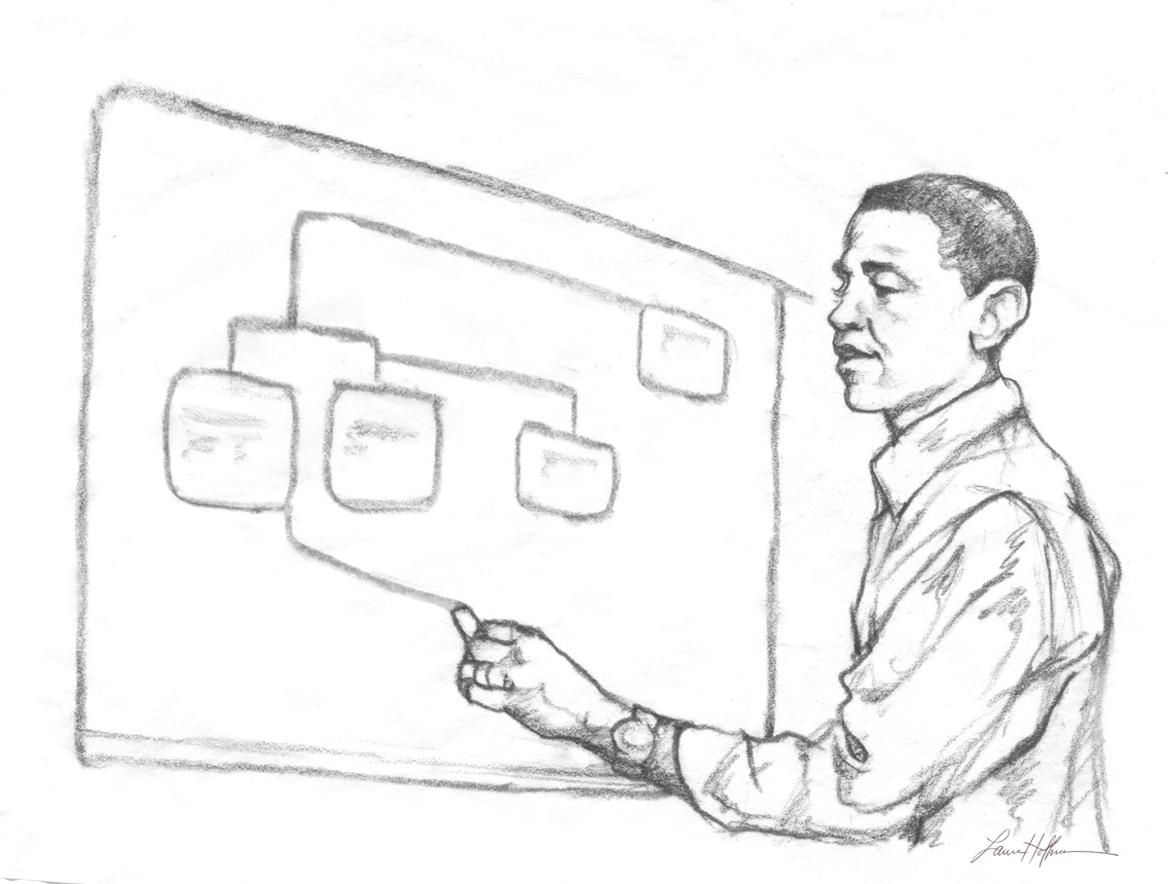
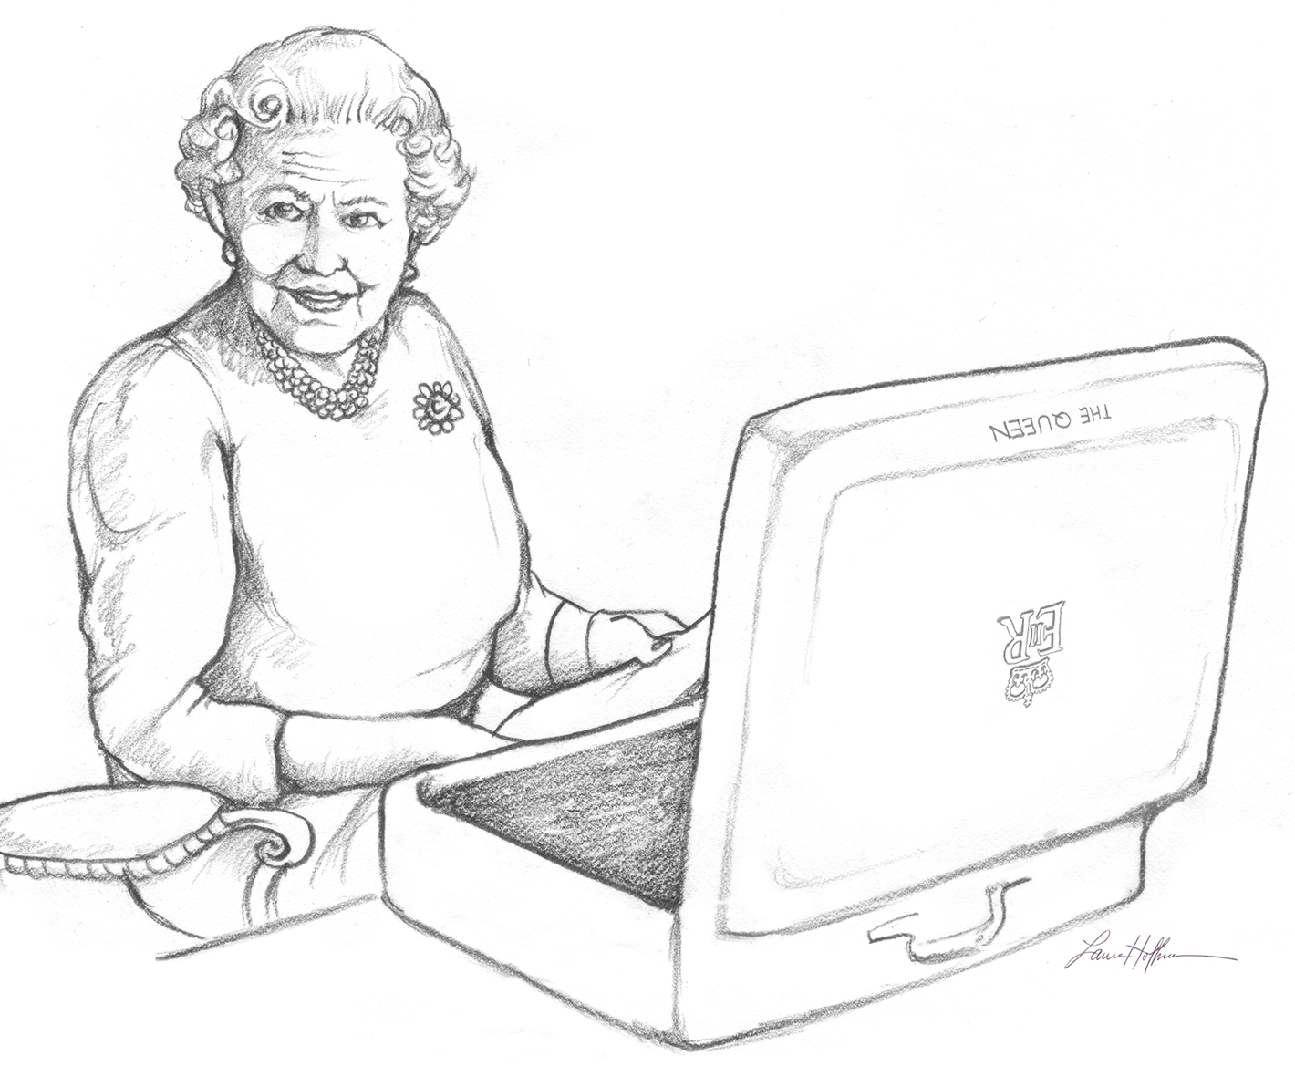
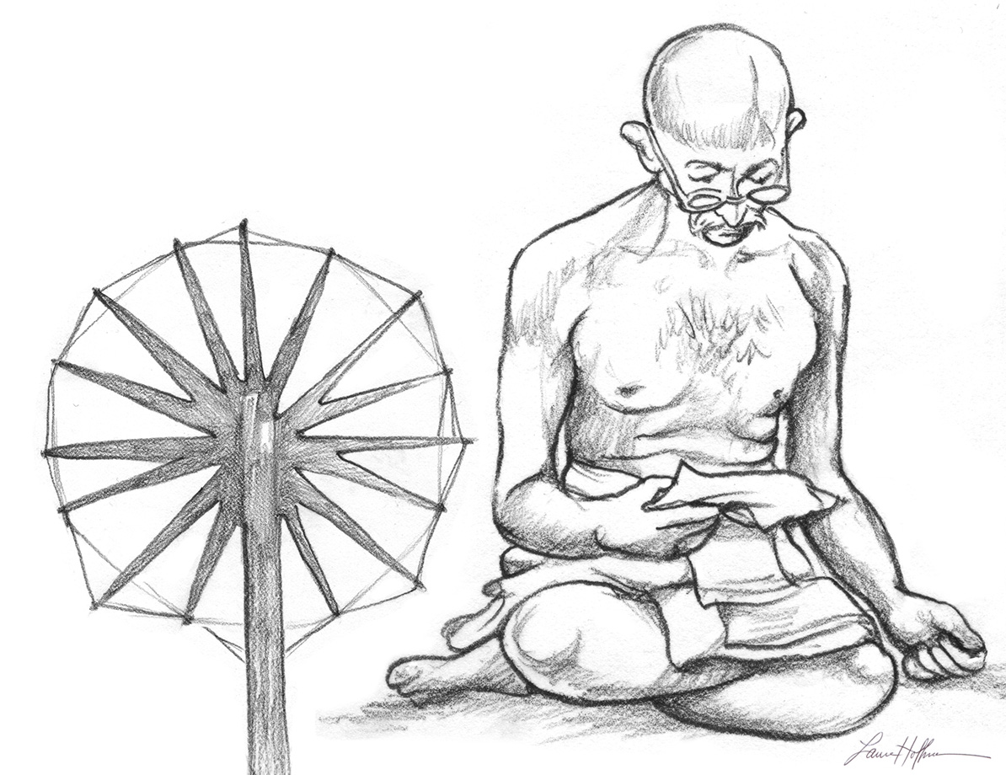

Slide 55
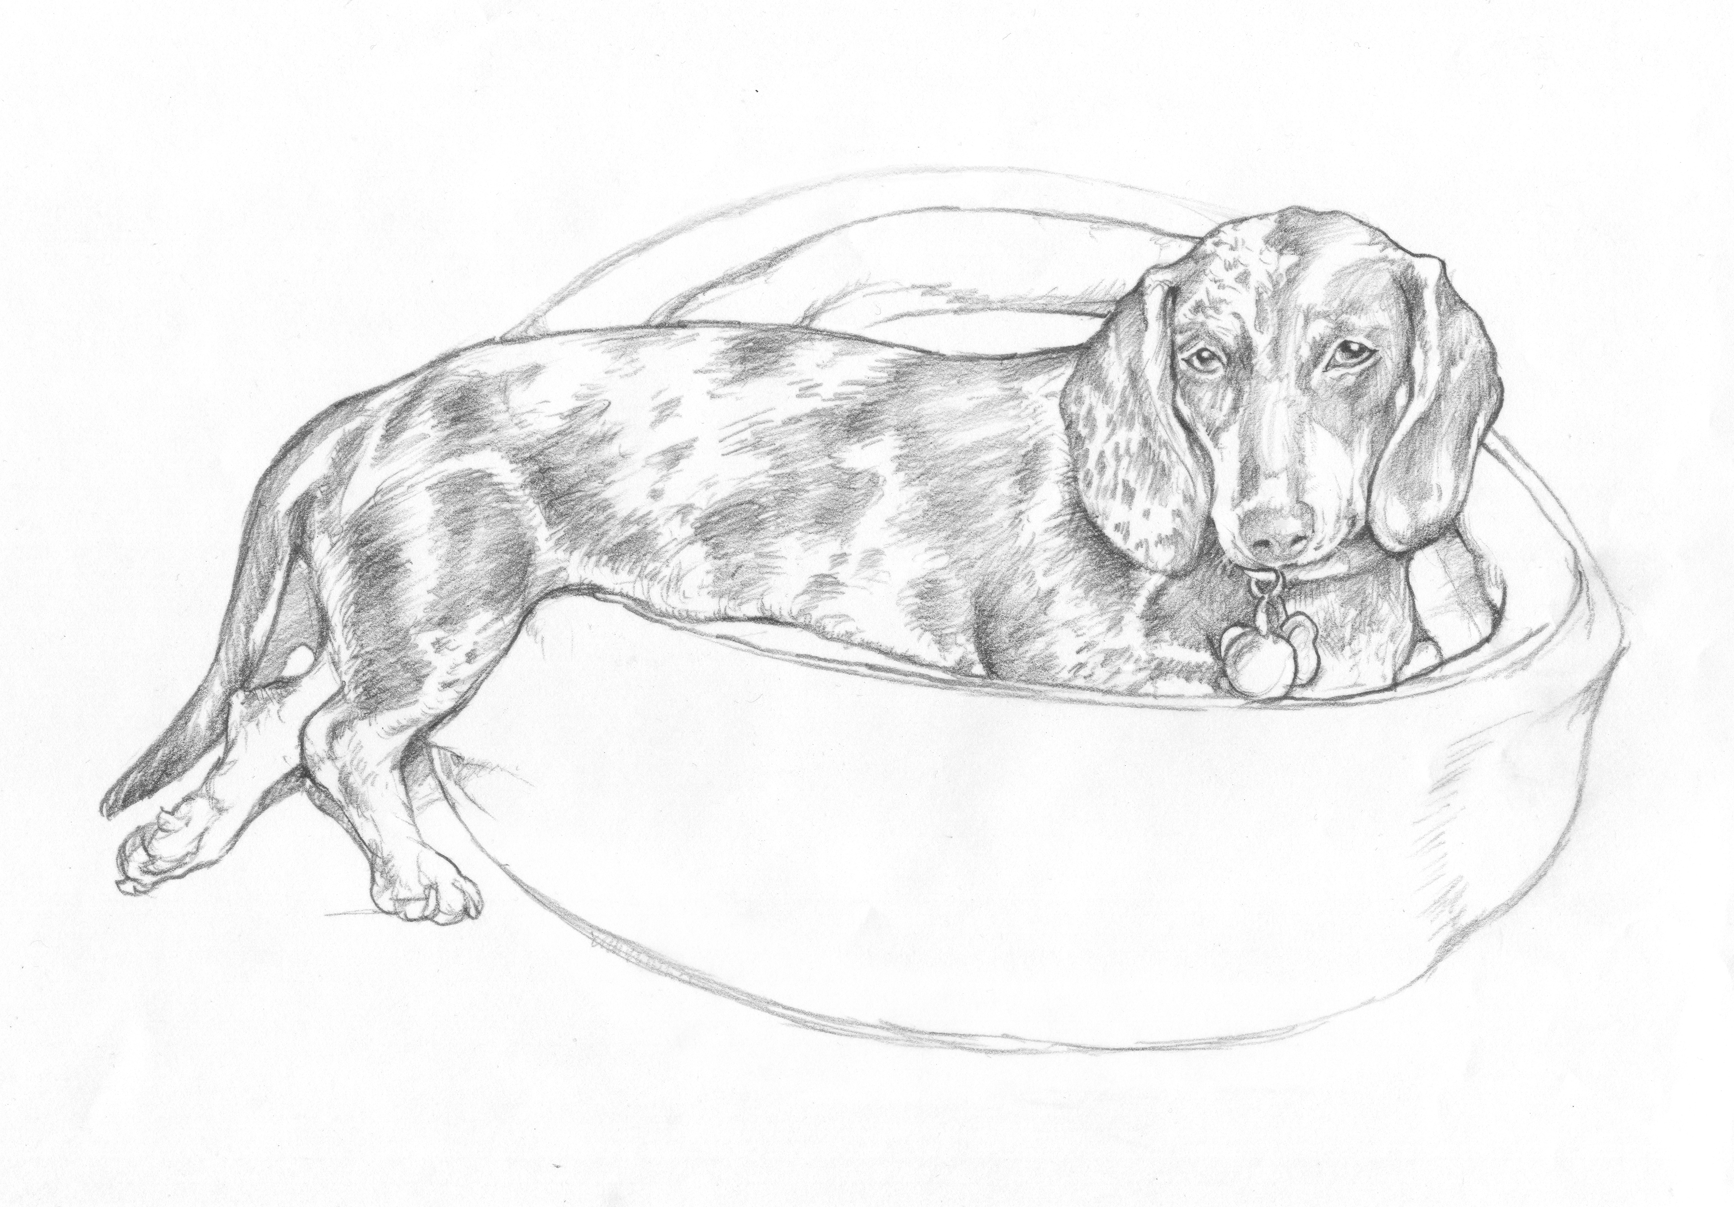

Slide 56
